Slide 1
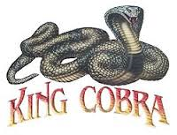
THE KING COBRA
By: Nathan & Brenden

Slide 2
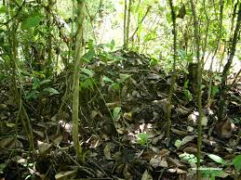
Distribution & Habitat
The King Cobra’s home is across the Indian subcontinent, South East Asia and the Southern areas of East Asia.
King Cobra’s Habitat area →
King Cobra’s Habitat →

Slide 3
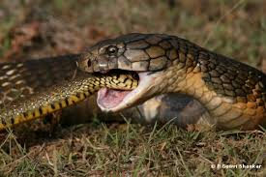
Behavior
The King Cobra receives chemical information Via it’s forked tongue. The tongue picks up scent.
The behavior of the kink cobra →

Slide 4
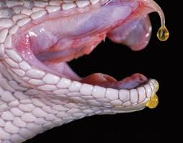
Venom
The venom of the king cobra is deadly several people died from this snake.
This is a picture of venom coming out →

Slide 5
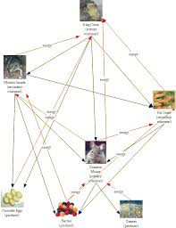
Diet
The King Cobra eats other snakes. It also eats mice and other small animals like other snakes and mice.
The King Cobra’s diet list →

Slide 6
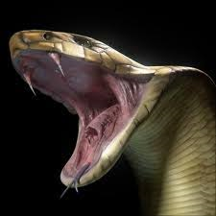
The Growling Hiss
The hiss of the King Cobra is a much lower pitch than many other snakes and many people thus liken its call to a ‘’Grow’’ rather than a hiss.
The King Cobra making a hissing sound→

Slide 7
Defense
A good defense against a Cobra for anyone who accidentally encounters this snake is to slowly remove a shirt or hat and toss it on the ground while backing away.

Slide 8
Ending
We hope you enjoyed learning about the King Cobra. The websites we used for info are wikipedia the free encyclopedia and we used google images. ;)

