Slide 1
Snow Wolves
By: Bailey and Jessie

Slide 2
Today me and Jess are going to tell you about the fearsome creatures… Wolves. Many people think that wolves are vicious creatures that stalk dark forests, terrorizing both man and beast. A wolf pack is just a family of wolves. Actually, most of our ideas about wolves are not true.

Slide 3
Wolves are the largest members of the dog family they grow to be 3 ft. (1m).
Lifespans of wolves differ based on breed and captivity. In general, wild wolves can live for up to 12 years, while wolves in captivity have been known to live for over 16 years. The record lifespan of a wolf is 20 years.

Slide 4
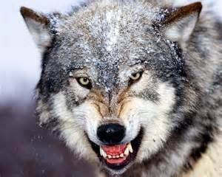
This is a wolf that is ready to attack the pray. If this guy or girl came to me or Jess I’m pretty sure that we’ll run or hide.

Slide 5
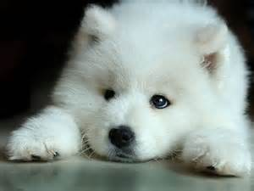
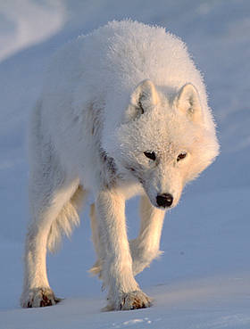
The first one is a baby wolf. Then once they get older they look like this. The difference is that one is older then the other and that one is in the snow and the other isn’t. Once the wolf gets to the age they go out and adventure without their parents.

Slide 6
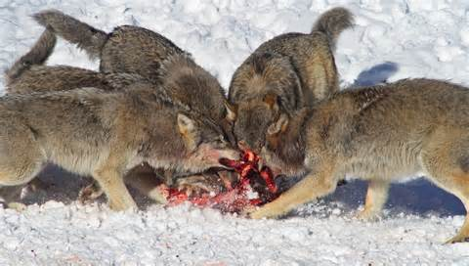
What do wolves eat? Wolves are carnivores (meat eaters) but they will eat other foods as well. Their diet ranges from big game, such as elk and moose, to earthworms, berries and grasshoppers. To avoid using too much energy catching their food, wolves prey on weaker members of a herd, such as old, young or sick animals. In summer, when the herds migrate, wolves eat mice, birds and even fish. Wolves eat their food very quickly, probably to protect it from being stolen, and to decrease the chance of attack from other predators. They eat the best parts first, and come back later for the remainder, as they can't afford to be wasteful. They will hide food in the snow, or icy soil, which helps to preserve it, and protect it from scavengers. Wolves can eat every 5-6 hours when there is plenty of food available, or they can fast and live on scraps for 2 weeks when there is less food around. Pups are fed by the adults who carry back fresh pieces of meat to the den.

Slide 7
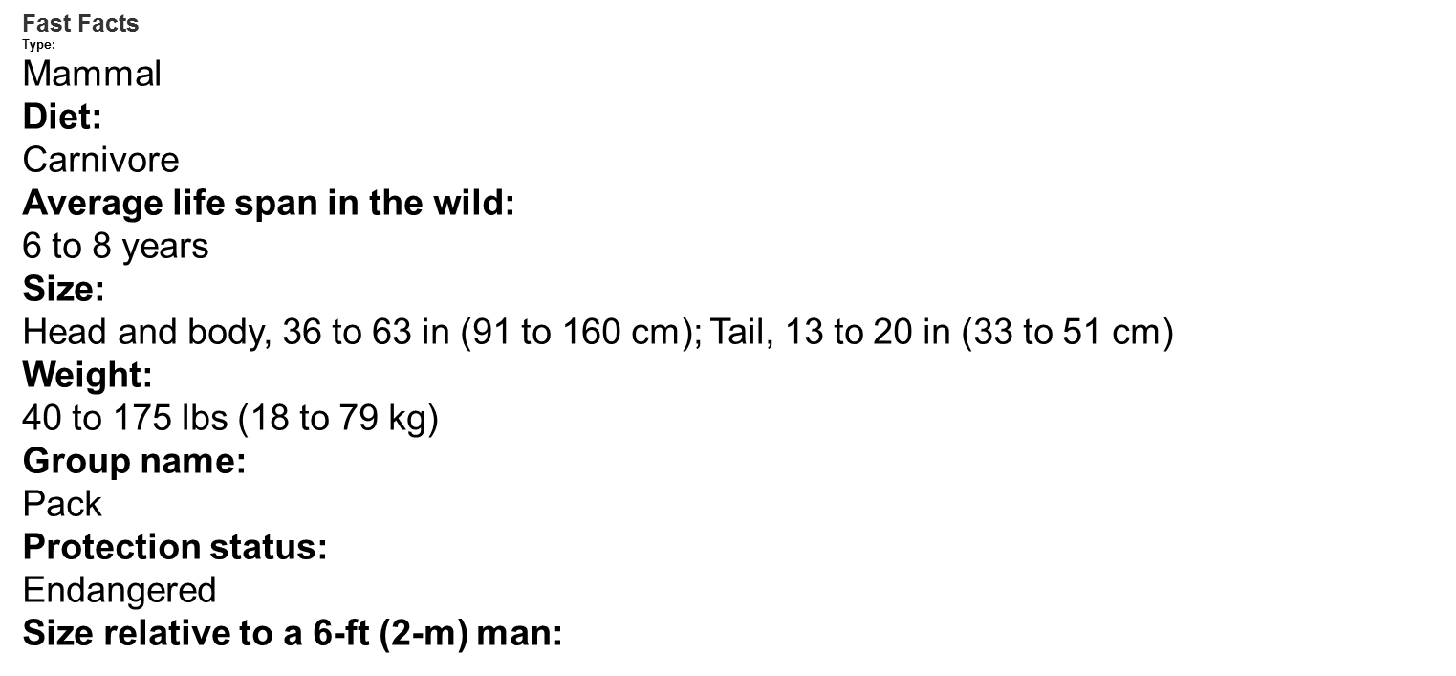

Slide 8
Wolves have an average of 6 pups, but have been known to have up to 14.

Slide 9
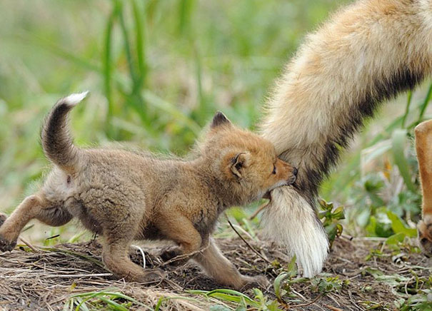
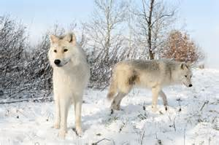
The first one is a baby pup that is grabbing onto the mothers tail to make sure that the mother is in front of him/ her. The second one is two snow wolves looking for food. The wolves need food just like us because if they don’t have food they will end up died. But they have enough speed, intelligence and if they hide before hunting they would end up being the BEST hunters ever(hint hint wolves.)

Slide 10
We hope you liked our presentation. We got our information from books such as Mammals. Wolves and wiki.☺

