Slide 1
Ravens
By Sam

Slide 2
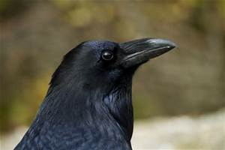
INTRO
IN THIS PRESENTATION I WILL BE TELLING YOU ABOUT ONE OF THE MOST SMARTEST BIRDS IN THE WORID THE RAVEN.

Slide 3
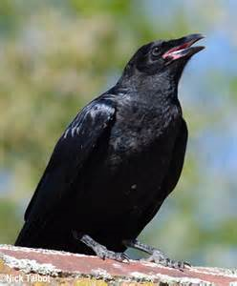
RAVEN FACTS
WHEN RAVENS ARE IN GROUPS THEY ARE CALLED MURDER OR UNKINDNESS
LIFE SPAN: 17 YEARS
WINGS SPAN: 100 – 150 (ADULT)

Slide 4
RAVEN MYTHOLOGY
WHITE RAVEN
THE WHITE RAVEN
RAVENS WHERE ONCE WHITE BUT IT WAS FOUND BY ANOTHER BIRD THROWING THE RAVEN INTO THE FIRE TURNING IT BLACK.

Slide 5
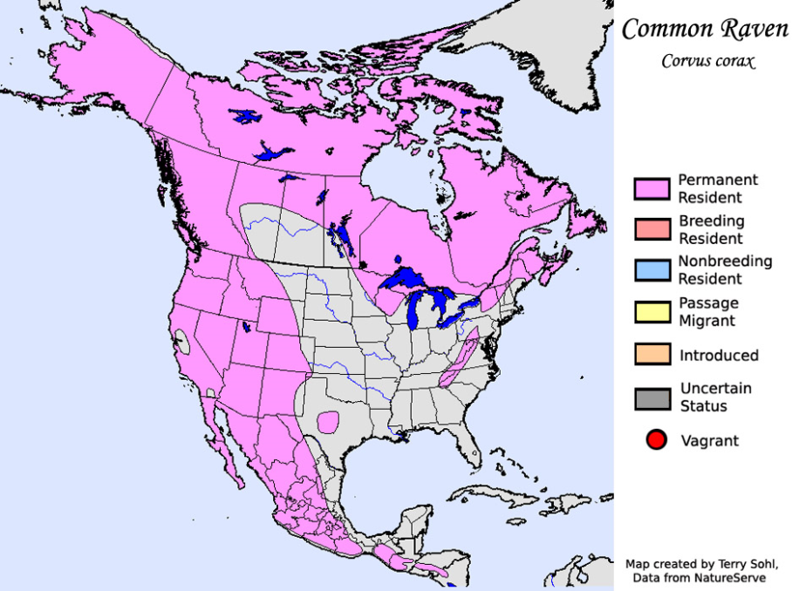
HABITATS
RAVENS ARE ADAPTADLE: THEY CAN LIVE IN A VARIETY OF PLACES. SNOW, DESERT, MOUNTAINS, AND FORESTS.
THEY WERE ALSO FOUND ACROSS THE NORTHEN HENISPER.

Slide 6
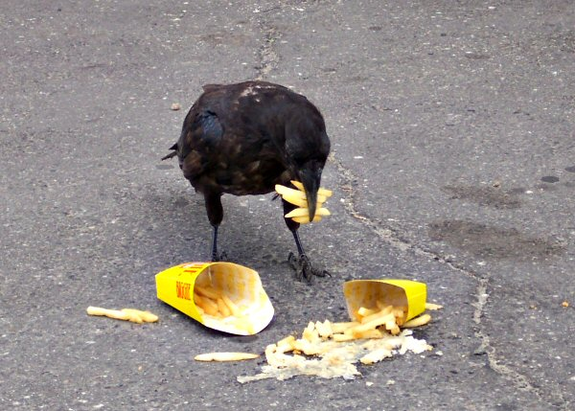
WHAT THEY EAT
RAVENS ARE SCAVENGERS WITH A HUGE DIET THAT INCLUDES FISH, MEATS, SEEDS, FRUIT, CARRION, AND GARBAGE.

Slide 7
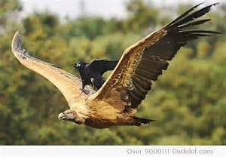
SMARTEST BIRD
RAVENS ARE ONE OF THE MOST SMARTEST ANIMALS WHEN IT COMES TO INTELLIGENCE, THESE BIRDS RATE UP WITH CHIMPPANZIEES AND DOLPHINS.

Slide 8
ENDING
THANKS FOR LISENING. I HOPE YOU LIKED MY PRESENTATION.

