Slide 1
PYRAMIDS
By: Jarvis and Dylan

Slide 2
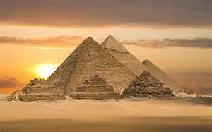
In this presentation, we will answer the following questions:
1) How did they build them?
2) What did they do with them?
3) How l0ng ago did they make them?
4) What was in them?
5) Why were certain objects placed inside pyramids?

Slide 3
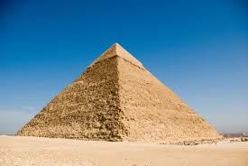
PYRAMIDS

Slide 4
About Pyramids
Did you know?
They make pyramids because when pharaohs died they were placed in the tombs of pyramids
Did you know? people built pyramids by putting the base of structure and adding stone by sliding them up ramps.
I believe they started building pyramids in 3500 bc and stop making them in 2000 ad

Slide 5
About Pyramids Continued
Egyptians also put in dead pets in tombs and dead servants of the pharaoh to work for him in the after life. Also, they put in treasure.
You may think, “why were those objects put in there?” The answer is because it’s a temple, or house, for the after life.

Slide 6
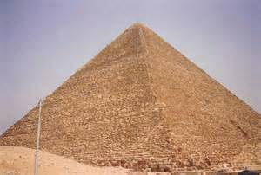
I HOPE YOU ENJOYED OUR SMALL LITTLE SHOW WE SET UP FOR YOU GUYS!
Jarvis did the typing while Dylan corrected me with my writing and a bunch of other helpfull things

