Slide 1
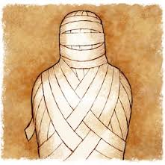
Mummification process
By: Hunter and Brenden

Slide 2
Introduction
We are going to tell you about the mummification process.

Slide 3
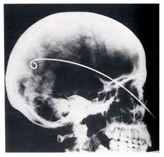
Step 1.
The first step to the mummification process is to remove the brain from the person.

Slide 4
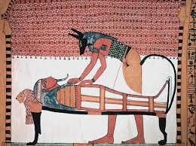
Step 2.
This step is to remove the organs except the heart and put them in some jars later on.

Slide 5
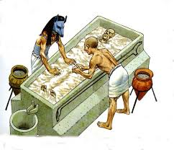
Step 3.
This step is to put the body in a special salt and leave it there for 40 days.

Slide 6
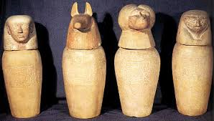
Step 4.
This step is to put the organs in jars called canopic jars.

Slide 7
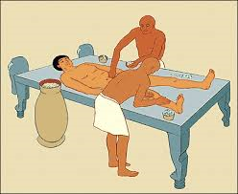
Step 5.
This step is to fill the body with sand linen and spices to give it shape.

Slide 8
Step 6.
This step is to put a mask over the head and put the body into a coffin.

Slide 9
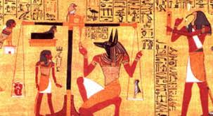
Step 7. (Final Step.)
This step is to weigh the heart and read the persons good deeds.

Slide 10
Fact about Mummification process
King Tut was the most famous pharaoh of all. He lived until 19 years old and was mummified. How he died is still a mystery.

Slide 11
Conclusion
Thank you for listening to our presentation. I hope you enjoyed it.☺

