Slide 1
Mining of ancient Egypt
By Nic

Slide 2
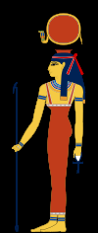
This is a mineshaft. A mineshaft is a long tunnel to go deep underground, to get to minerals. Miners worshipped Hathor, the "goddess of turquoise", who was believed to protect them.

Slide 3
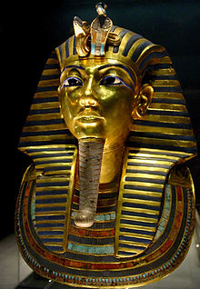
Lapis lazuli
Lapis lazuli is found deep underground normally in a mine. It is kind of common in Egypt. It was used for the eyebrows on the funeral mask of King Tutankhamun. Lapis is a deep blue semi-precious stone that has been prized since antiquity for its intense color.

Slide 4
Diamond
Diamonds are rare. They are also very valuable, they used them in jewels a lot. They were valued in ancient Egypt.

Slide 5
Gold
Gold was also very valued. They used them in rings and wigs and beads. Gold was affine common..

Slide 6
Limestone
Limestone was actually one of the minerals in the pyramids! It was highly valued in ancient egypt.

Slide 7
Zinc
:D
zinc is common in ancient Egypt. It was also valued.

Slide 8
Ending
In conclusion there are many ores in ancient Egypt.

Slide 9
ﻛ
This project is trademarked to ™

