Slide 1
Mental Health

Slide 2
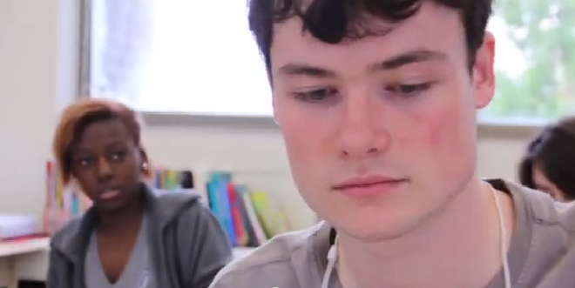
Mental Health
Stop the stigma

Slide 3
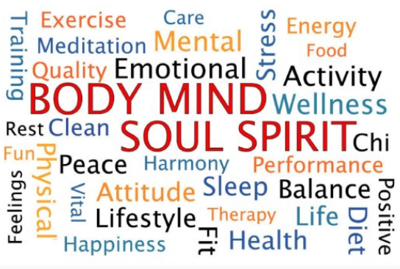
Mental Health
Mental health is a balance in all aspects of your life:
Social
Physical
Spiritual
Economic
Mental

Slide 4
Mental Health
Reaching a balance is a learning process
Your personal balance will be unique, and your challenge will be to stay mentally healthy by keeping that balance.

Slide 5
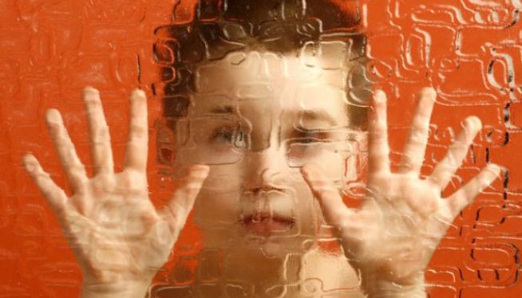
Mental Health
Mental health problems can affect youth as well as adults.
We need to assess our
emotional health regularly.
Think of the demands and the
stresses that are affecting us.
Give ourselves permission to
take a break from our worries.

Slide 6
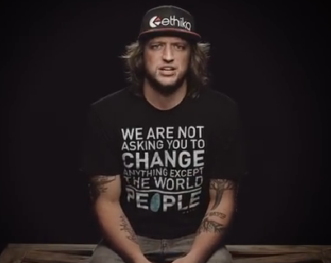
Mental Health
Judgment

Slide 7
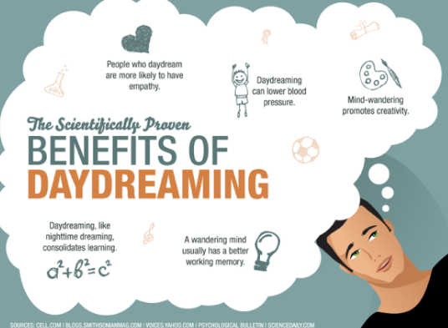
Some ways to practice mental fitness
Daydream – Close your eyes and
imagine yourself in a dream location.
Breathe slowly and deeply. Whether
it’s a beach, a mountaintop, a hushed
forest or your bedroom, let the
comforting environment wrap you in
a sensation of peace and tranquility.

Slide 8
Some ways to practice mental fitness
“Collect” positive emotional moments
Make it a point to recall
times when you have
experienced pleasure,
comfort, tenderness,
confidence, or other
positive emotions.

Slide 9
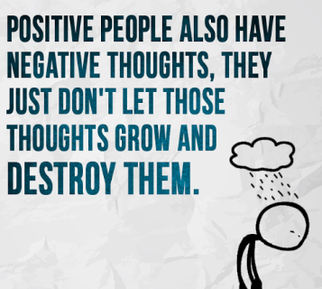
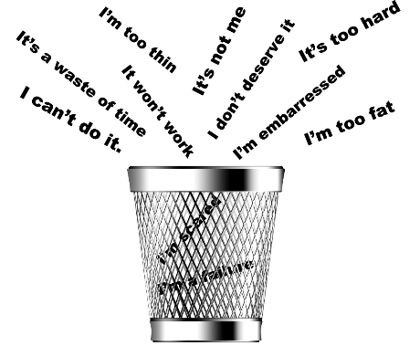
Some ways to practice mental fitness
Learn ways to cope with negative thoughts
Negative thoughts can be
insistent and loud.
Learn to interrupt them.
Don’t let them take over.
Try distracting yourself or
comforting yourself, if you can’t
solve the problem right away.

Slide 10
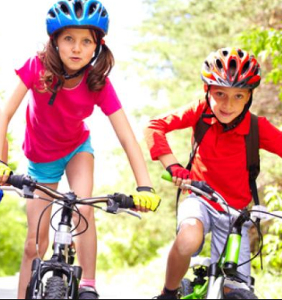
Some ways to practice mental fitness
Exercise – Regular physical
activity improves psychological
well-being and can reduce
depression and anxiety.
Joining an exercise group or a
gym can also reduce loneliness,
since it connects you with a new
set of people sharing a common goal.

Slide 11
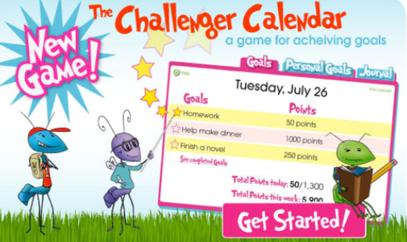
Some ways to practice mental fitness
Set personal goals
Goals don’t have to be big.
You might decide to finish
that book you started, take a
walk around the block every day,
learn a new game or to call
your friends instead of waiting
for the phone to ring
Whatever goal you set, reaching it will build confidence and a sense of satisfaction.

Slide 12
Some ways to practice mental fitness
Keep a journal (paper)
Expressing yourself after
a stressful day can help
you gain perspective,
relax and even boost your
body’s resistance to illness.
Do not post your feelings on the internet!

Slide 13
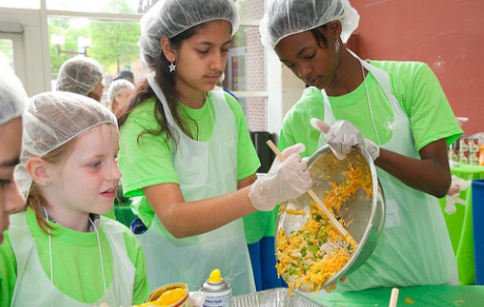
Some ways to practice mental fitness
Volunteer –
Volunteering is called the
“win-win” activity because
helping others makes us feel
good about ourselves.
It also widens our social network, provides us with new learning experiences and can bring balance to our lives.

Slide 14
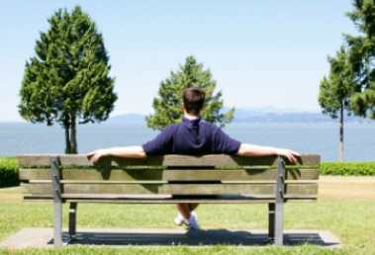
Mental Health
Treat yourself well
Have a good meal
Take a bubble bath
See a movie
Call a friend or relative you haven’t talked to in ages
Sit on a park bench and breathe in the fragrance of flowers and grass. Whatever it is, do it just for you.

Slide 15
Mindfulness Activity your teacher will read a mindfulness script
Begin by finding a comfortable way to sit
Close your eyes lightly
Concentrate on your breathing and
Listen…

Slide 16
Bibliography
https://www.cmha.ca/mental-health/your-mental-health/
http://www.themindfulword.org/2012/guided-imagery-scripts-children-anxiety-stress/
http://www.meditationinschools.org/wp-content/uploads/2013/06/Mindfulness-and-the-Art-of-Chocolate-Eating.pdf

