Slide 1
Meerkats
By: Shidanna and Kyle

Slide 2
Introduction
Today, Kyle and I will tell you all about meerkats. We will tell you what they look like, where they live, what they eat, what predators they hide from, and their behavior.

Slide 3
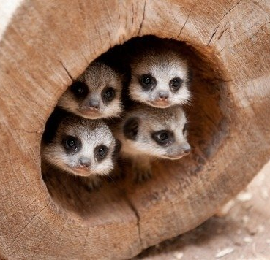
Appearance
Meerkats are small cats that can stand on their feet to look for prey.
A group of meerkats is called a "mob", "gang" or "clan". A meerkat clan often contains about 20 meerkats, but some super-families have 50 or more members.

Slide 4
HAbitat
Meerkats live in hot places like desserts in southern Africa.
they live in underground tunnels. They do leave their tunnels during the day except in the middle of the afternoon, to avoid the heat.

Slide 5
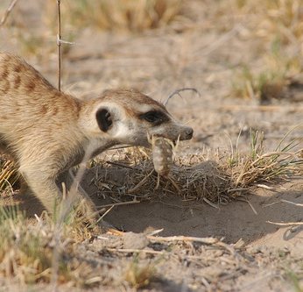
Food!
The meerkats eat lizards, frogs, spiders and lots of plants.

Slide 6
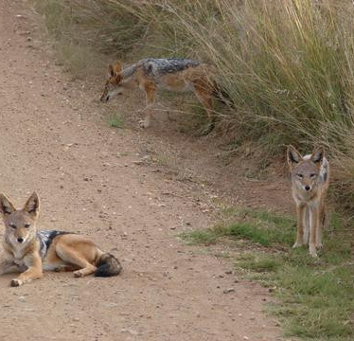
Predators
Meerkats’ predators are mostly big animals like eagles and jackals.

Slide 7
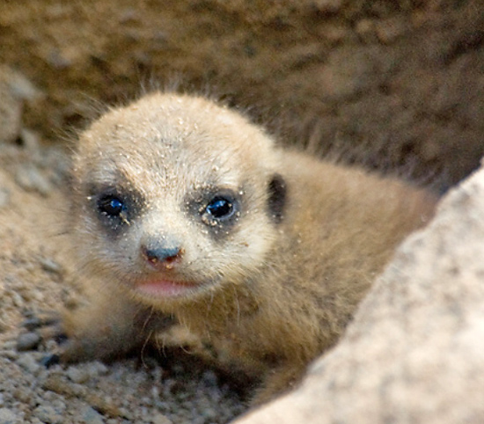
Behavior
To look for food, some meerkats spilt up to find food. When a predator is seen, a meerkat will blow the whistle so they can hide and not be eaten.

