Slide 1
May is Allergy Awareness Month

Slide 2
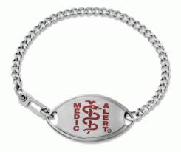
Did you know
A food related allergic reaction sends someone to the ER every 3 minutes.
Symptoms include: troubles breathing, low blood pressure. Sever reactions my result in death.
If someone you know wears a Medical Alert ID Bracelet, their allergy is very serious.

Slide 3
What is anaphylactic shock?
an·a·phy·lact·ic shock:
an extreme, often life-threatening allergic reaction to an antigen to which the body has become hypersensitive.
Anaphylactic Shock may very easily result from a serious allergic reaction.
Symptoms may be:
Skin system: hives, swelling, itching, warmth, redness, rash
Respiratory system: coughing, shortness of breath, chest pain/tightness, throat tightness, trouble swallowing
Gastrointestinal system: nausea, pain/cramps, vomiting, diarrhea
Cardiovascular system: pale/blue color, weak pulse, passing out, dizzy/lightheaded, shock
Other: anxiety, headache, uterine cramps, metallic taste

Slide 4
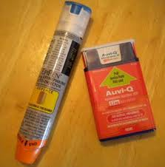
How can you help?
If you or someone you know is having an allergic reaction find the nearest sterile/unused Epipen or Allerject and follow these simple instructions.
Allerject:
https://www.youtube.com/watch?v=H6bpNcucjfs
Epipen:
https://www.youtube.com/watch?v=tjILFYPE3Uw

Slide 5
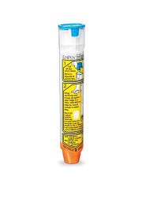
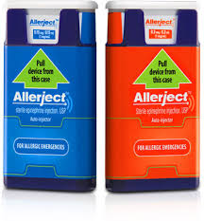
May is Allergy Awareness Month
Always inject the epinephrine(the medicine inside Epipen or Allerject) first for a better chance at saving yours or your friends life, then contact 9-1-1 immediately to be transported to the nearest hospital.
These few simple steps could save a life.

Slide 6
May is Allergy Awareness Month
Bring $2.00 on Wednesday to buy a bracelet in support of the Sweet Caroline Foundation

