Slide 1
megalodon
By hunter

Slide 2
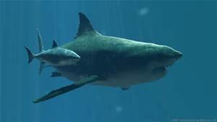
Answers
Today I'm going to answer your questions about the megalodon shark.
When it lived
its behavior
what it ate
how big it was
its relative
how many babies did it have

Slide 3
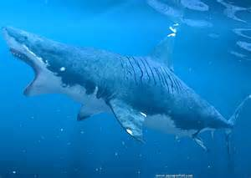
About the megalodon
The megalodon is an extinct species of shark that lived 15.9 to 2.6 million years ago.

Slide 4
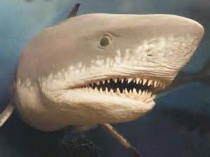
Its diet
We don’t know what the megalodon ate exactly, but we do know it ate whales and giant squids.

Slide 5
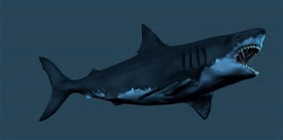
habitat
Megalodons lived in warm water. Nursery sites were found near Panama, Maryland (USA), and Florida(USA).

Slide 6
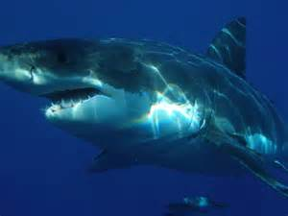
Its behavior
The megalodon has a similar behavior to the great white shark. it has a craving for meat, and doesn't stop swimming

Slide 7
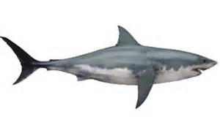
How big was it
The megalodon is about 60 feet long and about 32 feet wide. that’s really big!
When pups were born (live) they were between 2 or 4 meter's

Slide 8
Its relative
The megalodons’ relative is the great white shark. the megalodon looks very much like the great white shark. both of their teeth look very similar but the megalodons teeth are a bigger version of the great white shark’s teeth.

Slide 9
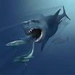
Biggest species
The megalodon was the biggest type of shark in the world. it may be extinct, we can tell it was extremely large because its teeth were huge.
Each tooth is 7 inches long.

Slide 10
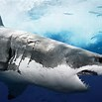
How many babies did it have
The megalodon number of babies is between 3 or 6 . The baby megalodons ate large sea turtles and baby megalodons were as tall as 3 to 4 meters.

Slide 11
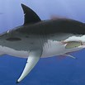
Still alive
Reported Megalodon sightings have some people wondering if the large predator in the ocean has ever seen might still be alive today, even though scienceints tell us it's impossible.
At maximum lengths of up to 60 feet long and 35 feet wide, the Megalodon was the most largest shark that ever lived. and the most fierce predator of its day. This terrifying monster lived at a time when the ocean was a very different place.

Slide 12
Thanks for listening
Before you go, I have a megalodon swimming in the water animation.
http://www.bing.com/videos/search?q=megalodon+animation&qpvt=megalodon+animation&FORM=VDRE#view=detail&mid=16271154466FD31B1DD816271154466FD31B1DD8

