Slide 1
Gods and Goddesses of Ancient Egypt
By Sam and Kyla

Slide 2
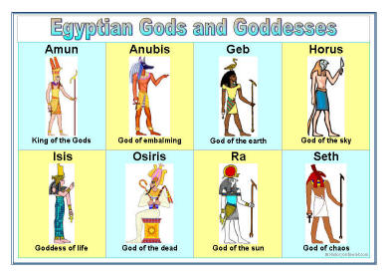
Intro
This power point is about the different Gods and Goddesses of Ancient Egypt. This includes Osiris, Amun/Amun –re, Bast, Anubis, Isis and Horus!

Slide 3
Amun/Amun-Re
Amun was the king god of Ancient Egypt. He was combined with Ra to become Amun-Re. By the 25th dynasty he was chief god of Ancient Nubia. This god was the only god that King Tut’s father believed in. He was the reason monotheism was created.

Slide 4
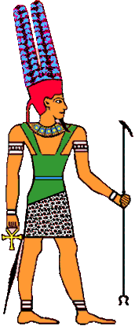
Amun/Amun-Re
He was believed to be the lord of the world. Amun-Re was associated with a bunch of different animals . He was shown with a hawk head, a ram head. That’s all I can remember.

Slide 5
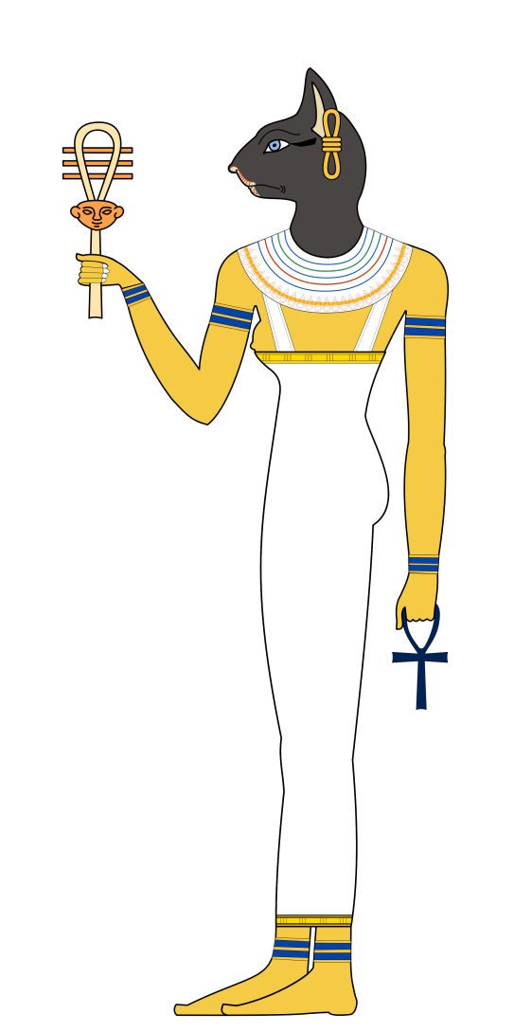
Bast - goddess of dancing and music
Bast had a cat head. She also protected women and children. She was a common god because cats were important in Egypt.

Slide 6
Anubis God of the Dead
Anubis was the jackal headed god of Egypt. He was also the god of embalming. He was one of the most important gods.

Slide 7
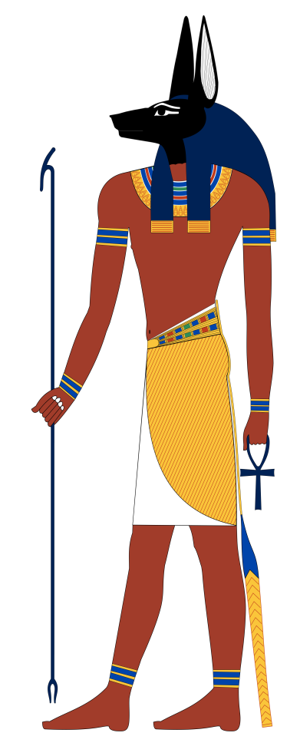
Anubis
Anubis had 5 sons/daughters. He used to protect the brain, heart, liver and kidneys. Being god of the mummies, he guided and helped them study to face Osiris’s test.

Slide 8
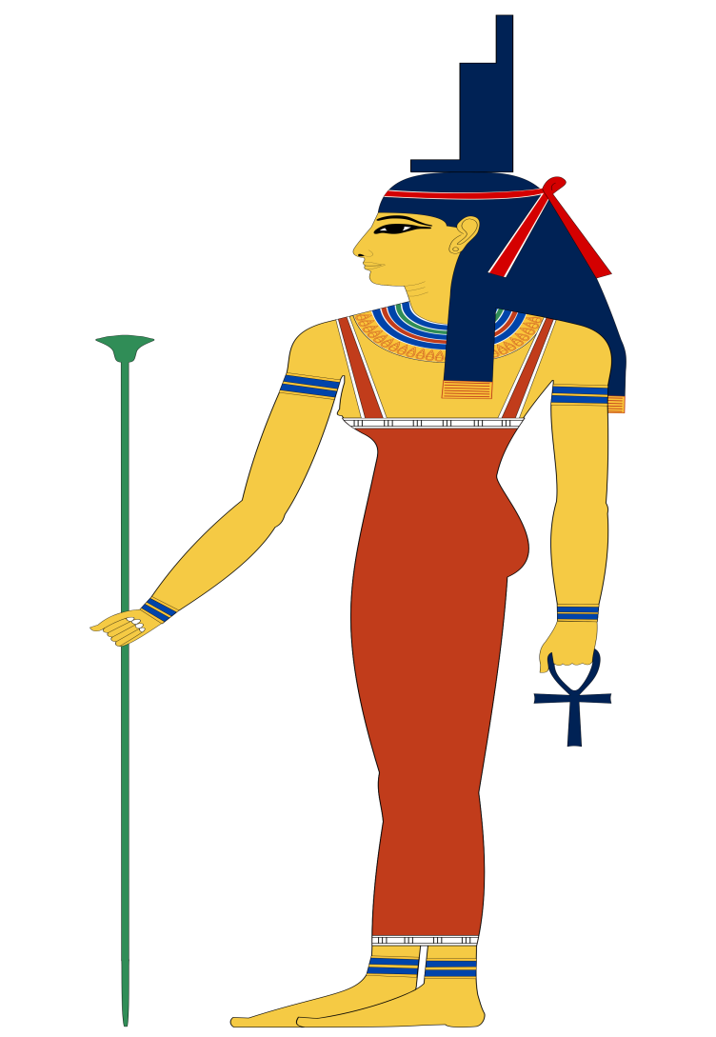
Isis - Mistress of magic
Isis was believed to be a mistress of magic. She was the wife/sister to Osiris. Also a mother to Horus. This mother adopted her sister’s child.

Slide 9
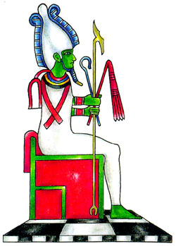
Osiris God of the Dead
Osiris was a very popular god. He was killed by his brother then he took the god of the dead name. Being god of dead he would judge the dead person by their heart to see if they could come in his kingdom of the dead. As well as being god of the dead he was also god of feritilly.

Slide 10
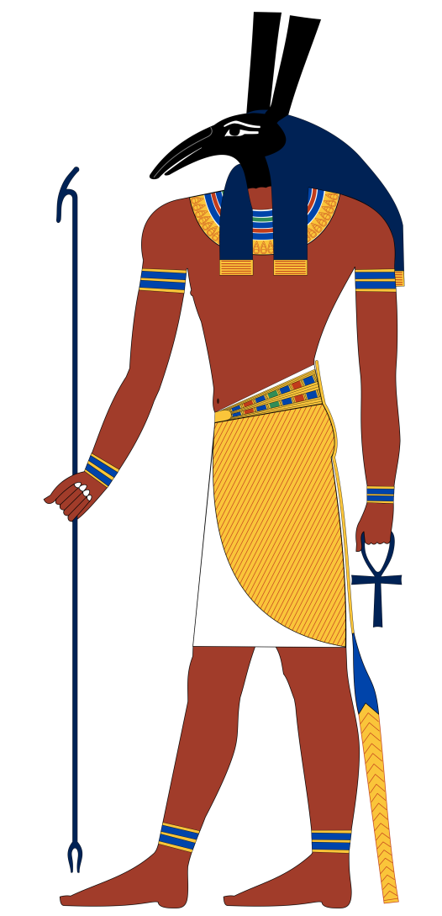
Horus
God of the sky with the god of dead as his dad who was killed by his unkle. Horus was rasied by his mom. When he had the right to claim the throne he had to fight his unkle. He won and got control of the kingdom once more!

Slide 11
Conclusion
We used an Ancient Egypt app to study for this. We also used an Ancient Egyption text book
Those were some of the many gods and goddess of Ancient Egypt. There are many more if you willing to spend a lot of time to study it.

