Slide 1
Raccoons
BY Gavin

Slide 2
intro
Today I will be talking about Raccoons. I will talk about where they live, eat, and more. By the end , you will know a lot about raccoons. I hope you enjoy.

Slide 3
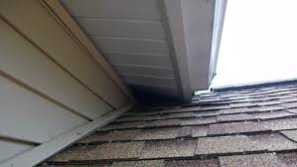
Raccoon homes
Some Raccoon homes are found in trees.
Also some homes are in forests.
Sometimes they get in your attic .
This is how they get in …

Slide 4
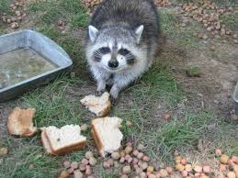
Raccoon food
Raccoons can eat what we eat .
Normally they eat garbage.
Sometimes they eat berries.

Slide 5
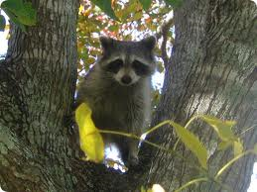
Raccoons’ diseases
Raccoons carry diseases like rabies . To get it you have to get scrached or bit

Slide 6
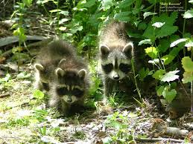
Raccoon facts
A Raccoons can weigh up to 3.5 too 9 pounds.
Did you know you should never corner a Raccoon because he or she will attack.
They do that because they feel threatened
All babies look the same but smaller as you see.

Slide 7
Ending
I hope you enjoyed this presentation. I used Google image and Wikipedia.

