Slide 1
Northern Flying Squirrel
By: Rylie and Khalid
0

Slide 2
Intro
We really hope you enjoy our report. We will be talking about the northern flying squirrel’s appearance, habitat, diet, behavior, and reproduction.

Slide 3
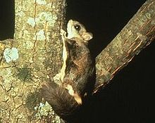
Diet
The northern flying squirrel can easily hunt for food at night. It hunts bird eggs, fungi, and nuts. It gets around extremely fast because it glides from tree to tree. It’s an omnivore.

Slide 4
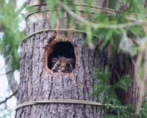
Habitat
Nests are built within mature trees; often abandoned woodpecker holes are filled with shredded bark. They live in areas where there are a lot of food. They live in a moderate climate, or hot climate, such as Canada, or USA.

Slide 5
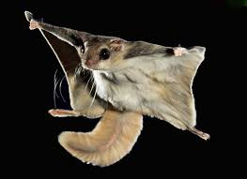
Flying and Gliding
Flying squirrels do not actually fly, but travel by gliding from one tree to another. This is accomplished by stretching the legs. Glides are usually only about 6-9 m in length, but may extend up to 30 m.

Slide 6
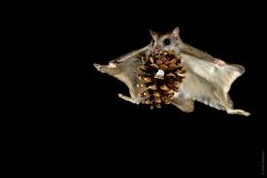
Behavior
Northern flying squirrels nest in holes & trees, preferring large diameter trunks and dead trees, and will also build outside leaf nests called dreys and will also nest underground.

Slide 7
Reproduction
They raise their young in nests. Sometimes, they even raise them underground.
The only difference between the babies and adults, is size, and their fur coats are different.

Slide 8
The end
Thanks Wikipedia for the information.
Thanks for listening to our presentation.

