Slide 1
Flamingos by :Paige

Slide 2
what animal born from an egg, gray or white and grows to be tall and beautiful bird ???????
If you guess flamingo your right and I will be telling you where they l live , they eat and lots more !!!!!!

Slide 3
Where flamingos live
Flamingos live in lots of different places like :
lagoons
shallow lakes
tidal flats
areas mixed with ocean and water
and in regions that have very little food .

Slide 4
What flamingos eat
flamingos eat mostly the same kinds of food they eat : brine shrimp ,blue - green algae and anchovies

Slide 5
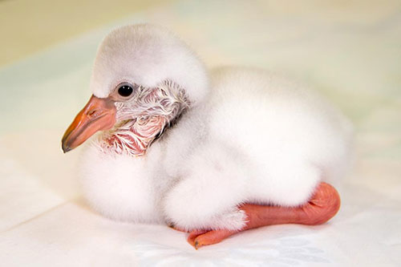
what they look like
You may think flamingos are pink but actually they’re grey or white when they are born and as they get older the pinker they get caused by the pink food they eat .

Slide 6
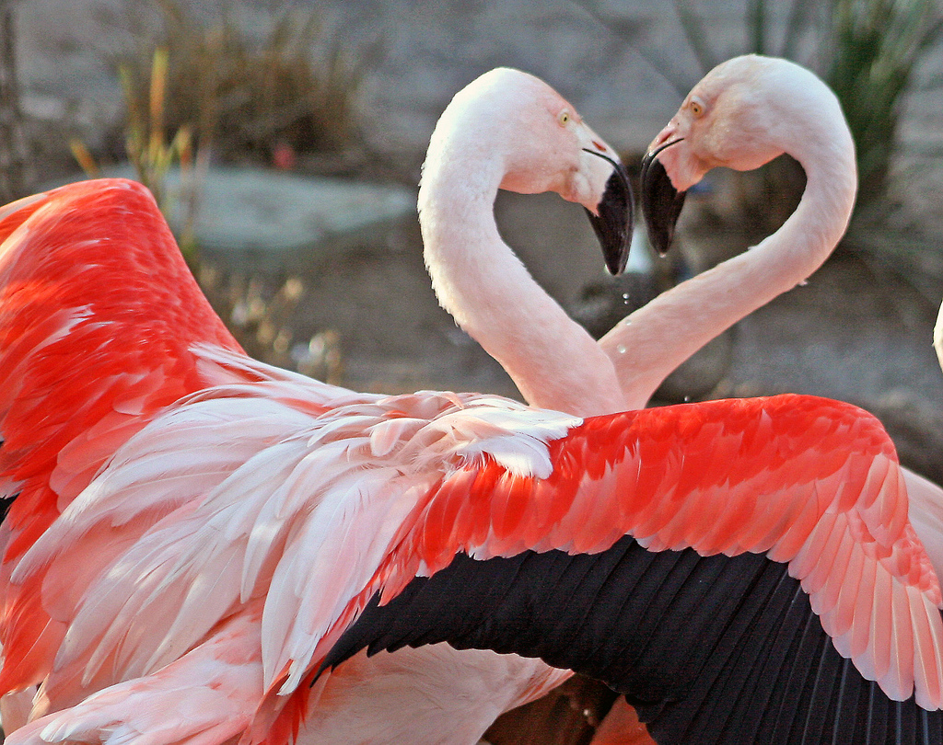
Behavior
Flamingo's enjoy long watery walks after a romantic date. Occasionally the flamingos will shake it up and have a bath together and go wild.

Slide 7
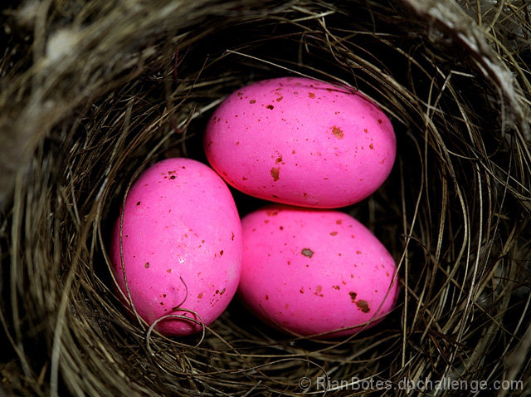
Reproduction
Normally a flamingo lays a single egg and raises just one chick. If the first egg is destroyed they might lay a second one, but they don't have amounts of eggs at once .

Slide 8
Thanks for watching my power point I hope you liked it !!!!!
Thank to answer.com and Wikipedia

