Slide 1
Welcome To Mme Arbeau’s
Homeroom Class
Harry Miller Middle School
2015 - 2016

Slide 2


Slide 3


Slide 4
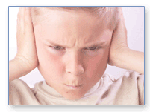

Slide 5
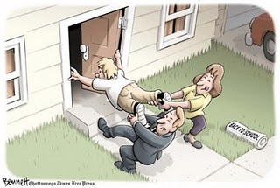

Slide 6


Slide 7
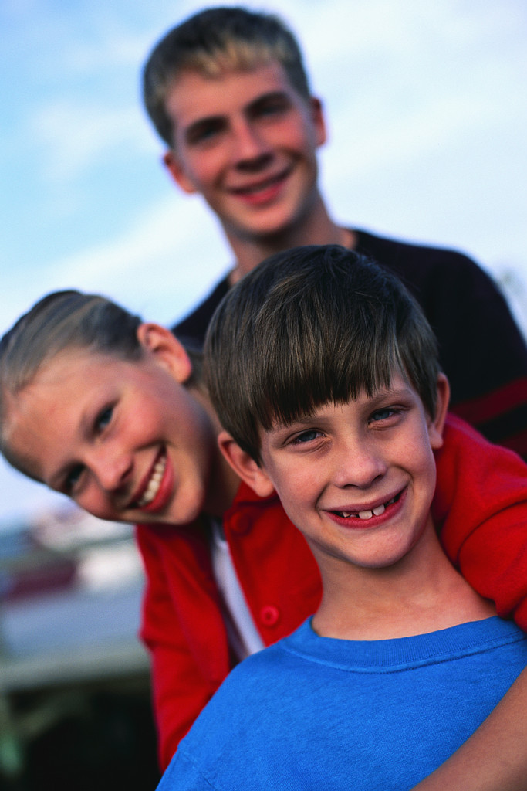

Slide 8

Notes:
How are you getting home? Do you know your bus number?

Slide 9
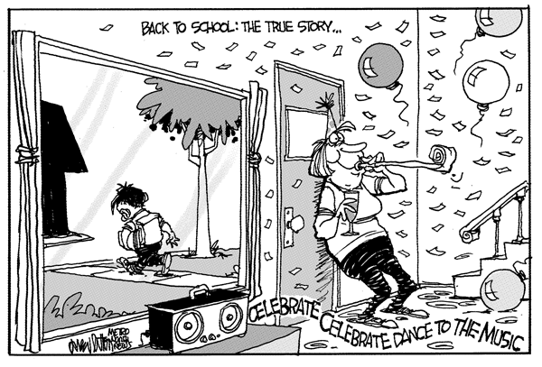

Slide 10
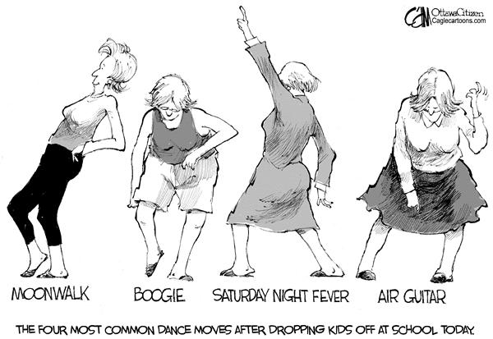

Slide 11


Slide 12

The First Week Of School

Slide 13


Slide 14
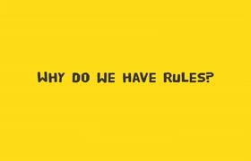

Slide 15
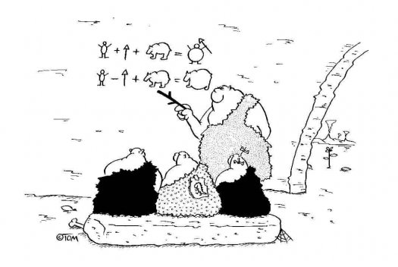
School rules are necessary if we want to live and study happily at school.
School rules have been around for… well, as long as there have been schools

Slide 16
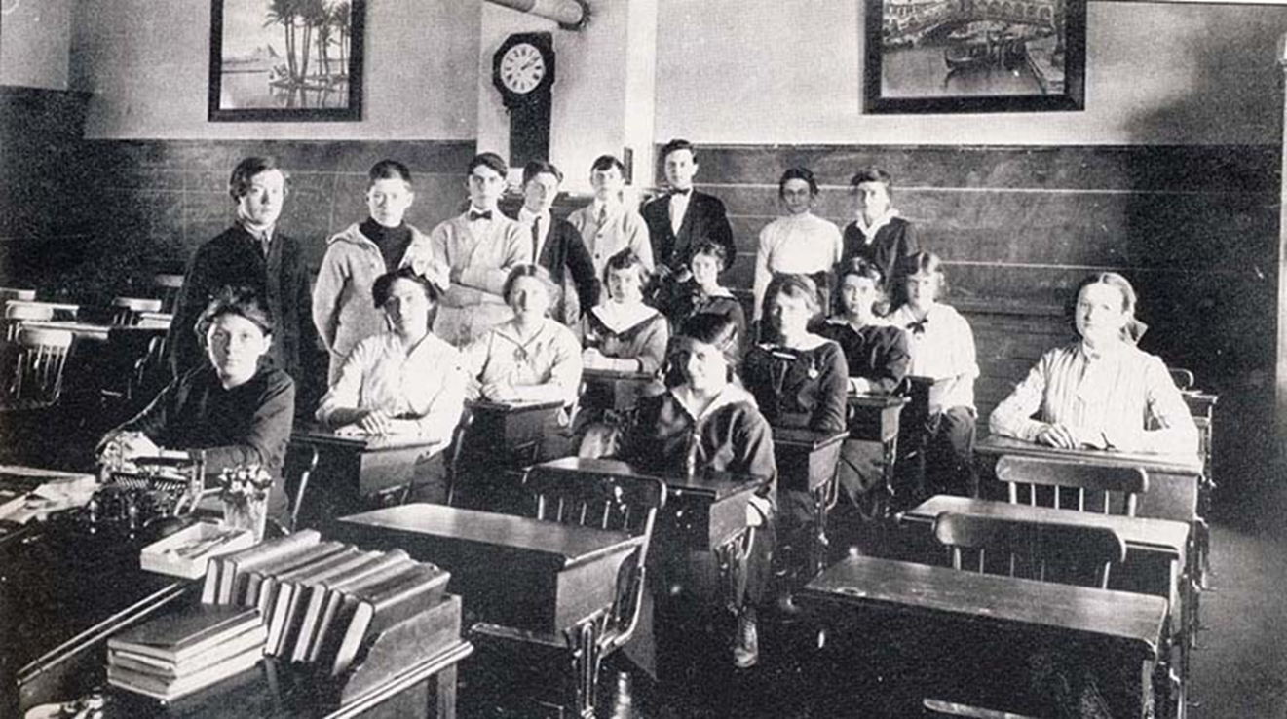

Slide 17
Student Rules, 1860
Boys and girls shall file into classroom in separate lines and be seated quietly on opposite sides of the room.
Boys shall remove their caps when entering.
Children must sit up straight at all times.
Children must not squirm, fidget or whine.
Children must be clean and tidy in clothing.
There will be a daily inspection of neck, ears and fingernails prior to class to ensure cleanliness of person.
Young ladies must never show a bare ankle; girls’ and boys’ clothing should cover arms and legs completely.

Slide 18
Punishments, 1860
Five minutes tardy in the morning = 1 hour after school.
Double assignments if homework is not done.
Nothing shall be dipped into ink wells except pens.
Children who are caught writing with their left hand = 1 ruler rap on the knuckles.
Do not speak unless spoken to by the teacher. Talking in class = 1 whack with a rod.
Nothing shall be thrown in class. Such behavior = 5 whacks with a rod.
Chewing of tobacco or spitting = 7 whacks with a rod.
Speaking immoral language = Suspension.
Carving on desks or defacing school property = Expulsion.
Fighting, lying, or cheating = Expulsion.
ONLY WELL MANNERED CHILDREN MAY ATTEND SCHOOL.
REMEMBER: EDUCATION IS A PRIVILEGE.

Slide 19
Rules for Teachers in 1892
Teachers each day will fill lamps and clean chimneys.
Each teacher will bring a bucket of water and a scuttle of coal for the day’s session.
Make your pens carefully. You may whittle nibs to the individual taste of the pupils.
Men teachers may take one evening each week for courting purposes, or two evenings a week if they go to church regularly
After ten hours in school, the teachers may spend the remaining time reading the Bible or other good books.
Women teachers who marry or engage in unseemly conduct will be dismissed.
Every teacher should lay aside from each pay a goodly sum of his earnings for his benefit during his declining years so that he will not become a burden on society
Any teacher who smokes, uses liquor in any form, frequents pool or public halls, or gets shaved in a barbershop will give good reason to suspect his worth, intention, integrity and honesty
The teacher who performs his labor faithfully and without fault for five years will be given an increase of twenty-five cents per week in his pay, providing the Board of Education approves.

Slide 20

NB Education Act:
Duties of pupils
14(1)It is the duty of a pupil to
(a)participate in learning opportunities to his or her potential,
(b)accept increasing responsibility for his or her learning as he or she progresses through his or her schooling,
(c)attend to assigned homework,
(d)attend school regularly and punctually,
(e)contribute to a safe and positive learning environment,
(f)be responsible for his or her conduct at school and while on the way to and from school,
(g)respect the rights of others, and
(h)comply with all school policies.

Slide 21

School Policies at HMMS?

Slide 22



The 3R’s of HMMS
Respect of self and others.
Responsibility for your actions.
Right Choices –You need to make choices that are right for you and show respect and responsibility.

Slide 23
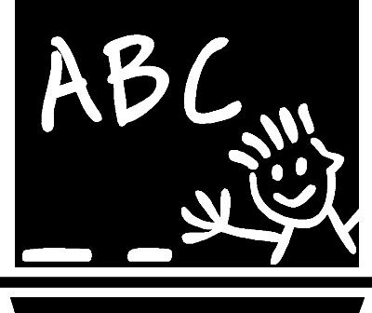
ABC’s of Harry Miller Middle School
Come to class ready to work and learn.
Make sure you have:
A – Agenda
B – Books
C – Correct Materials

Slide 24
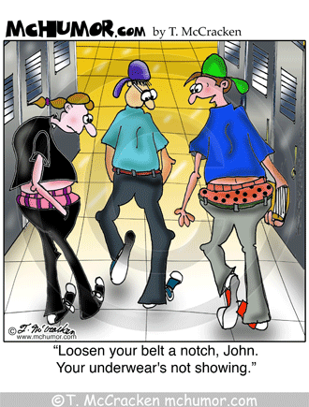
School Dress Code
Students are expected to keep their bodies covered – for the girls you are not to wear spaghetti straps – use the lasagna noodle rule.
Undergarments should not be visible
Skirts and shorts are to be no shorter that two inches above the knee .
What is appropriate at in other situations is not always acceptable at school.

Slide 25



Hands off, Mouth off,
Body off
At HMMS we maintain that all staff and students have the right to teach and learn in a respectful atmosphere.
Pupils have the right to be taught and to learn without being disrupted by others and have the responsibility not to disrupt others.

Slide 26

Electronic Devices
H.M.M.S does not encourage students to bring electronic devices (cell phones, MP3 players, game boys, cameras, etc.) to school.
If students choose to disregard this advice we ask that they keep ALL electronic devices locked in their lockers during the instructional day
If anything is lost or stolen it will be your responsibility- not the responsibility of the school to find or replace it.
Students may use devices to listen to
music/play games @break/lunch

Slide 27

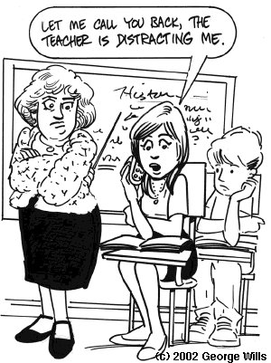

Slide 28
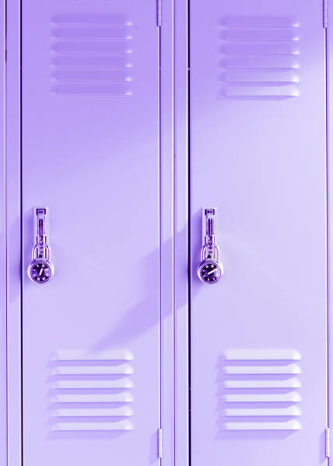
Lockers
Each student will be provided with locker space and a lock.
Keep your locker LOCKED!
You are responsible to keep your locker clean and tidy.

Slide 29
Cafeteria
Put all chairs down if you are the first students in for early lunch.
Keep everything set up as it is (no moving of tables or chairs).
There is to be a maximum of 2 people on a chair.
Please clean up your space before you leave and push in your chair. Make sure to recycle.
Put your dirty dishes and tray where they belong.
One serving line

Slide 30
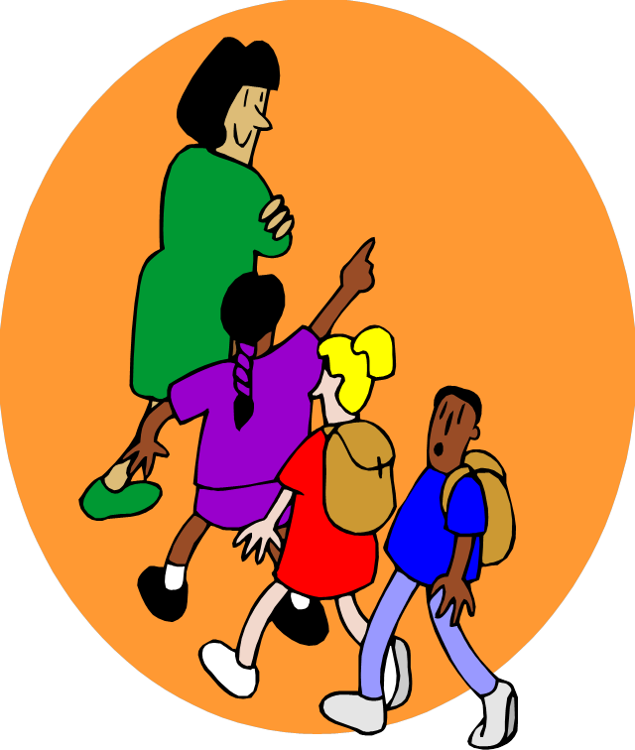
Hallways/Stairs
Remove your hat as you enter the building.
Walk on the right hand side of the hallways in single file.
Keep the garbage off of the floor.
Please deposit garbage and recyclables in the appropriate bins.
Do not stop at fountain or
washroom between classes

Slide 31
Noon Hour
We are a “closed” campus.
Only students who walk to school may leave the grounds at lunch IF they have the proper forms signed and returned to the main office. (Forms available in the main office)
Skateboards and bikes may only be used at the side of the school– helmets must be fastened, and the permission slip must be signed and returned to the school office before using these items.

Slide 32
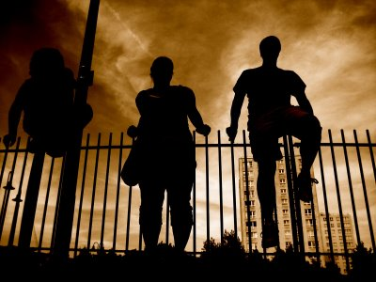
School Yard
No climbing or sitting on the walls or
snow banks
No climbing the fence
Soccer field boundaries (fire hydrant)
Side hill off limits
NEW BOUNDARIES!

Slide 33
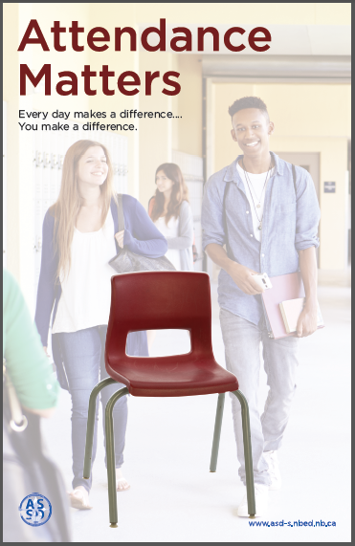
Attendance
“We know that being present and on time has a positive impact on learning from K-12. It is difficult to “catch up” when time is missed, and for some children starting the day late can impact their entire day. Good school attendance helps to build habits that will last a lifetime and transfer to life beyond public school.”

Slide 34
Attendance
If you are absent you need to provide a written excuse
If you arrive after the bell in the morning you need to sign in at the main office.
If you leave at any time during the day you need to sign out.
If you return to school, you will need to sign back in.
If you leave at noon hours you must sign out and then sign in upon return.
You are responsible for any work you miss while away from school.

Slide 35

Textbooks
Make sure that you cover your textbooks to personalize them once they have been issued to you by your teacher… Do not mark on them or inside them.
If you lose a textbook you will be billed for it.
The average cost of a new text is $70.

Slide 36

Locker Rooms
Do NOT take money or any other valuables into the locker rooms – we had several items taken last year.
Leave all money or valuables locked in your locker, or give to your teacher.

Slide 37

Fire Alarm
Quiet! Calm!
Windows closed… lights off
Exit to hall (last out closes door)
Turn left
Towards the portables
Out Portable Door
Turn right
Away from building
Walk to field
Line up – single file
Quiet! Calm!

Slide 38

Emergency Lockdown
“This is an Emergency Lockdown.”
Quiet! Calm!
Lights off… windows closed…blinds down
Quiet! Calm!
Get to a spot that’s out of sight from door
Quiet! Calm!
Sit
Quiet! Calm!
“The emergency lockdown is over.”

Slide 39


Slide 40

Teaching and Learning Come First!

Slide 41
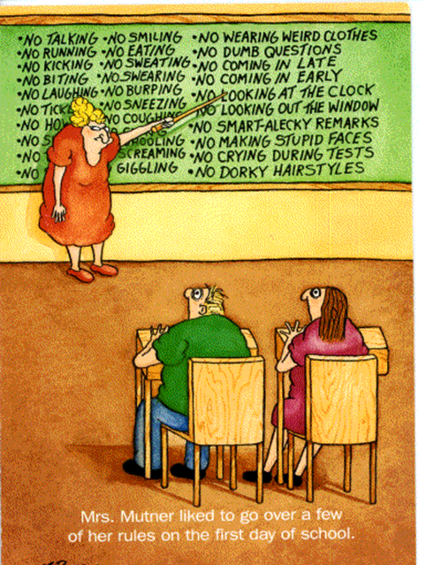

Slide 42
The 3R’s of HMMS
Respect of self and others.
Responsibility for your actions.
Right Choices –You need to make choices that are right for you and show respect and responsibility.

Slide 43
The 3 R’s In Our Classroom
Look Like And Sound Like:
Respect | Responsibility | Right Choices

Slide 44
The 3 R’s In Our Classroom
Look Like And Sound Like:
Respect | Responsibility | Right Choices
Raising your hand to speak Being prepared Being honest Listening to others Doing homework Putting garbage in garbage can Paying attention: eye contact, answering questions, asking question, taking notes Being on time… you and your work Following rules “Yes, Sir.” “Please.” “Thank-you.” “You are welcome.” Pushing in your chair No back talk , sass, or arguing Taking care of school property Treating others the way you want to be treated. “It’s mine… I’ll take care of it.” “I am sorry…” “I’ll fix it.”

Slide 45
The 3R’s @ Work
Respect | Responsibility | Right Choices
Raising your hand to speak | Being prepared | Being honest
Listening to others | Doing homework | Putting garbage in garbage can
Paying attention: eye contact, answering questions, asking question, taking notes | Being on time… you and your work | Following rules
“Yes, Sir.” “Please.” “Thank-you.” “You are welcome.” | Pushing in your chair
No back talk , sass, or arguing | Taking care of school property
Treating others the way you want to be treated. | “It’s mine… I’ll take care of it.”
 | “I am sorry…” “I’ll fix it.”

Slide 46
Specific Expectations for Mme Arbeau’s Classroom…
Come to class ready to work and learn.
Make sure you have:
      A – Agenda
      B – Books: SILENT READING NOVEL
      C – Correct Materials
          Duotang
          Pen and pencil (eraser)

Slide 47
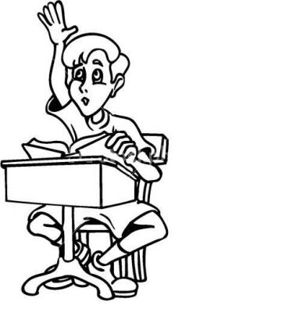


Specific Expectations…
Come in… Sit down… Get ready to work and learn
Stay seated – no wandering
Raise your hand to move from your seat (washroom, garbage can,, etc.)
Raise your hand to speak (ask or answer a question)
Don’t write or draw on your desk
Unwanted paper goes into the recycle bag
Garbage goes into the garbage can.
Keep nothing in “your” desk.
Hand your work in on time

Slide 48
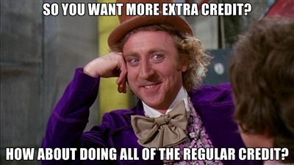
AND HANDING IT IN ON TIME!

Slide 49

Does anyone have any questions?

