Slide 1
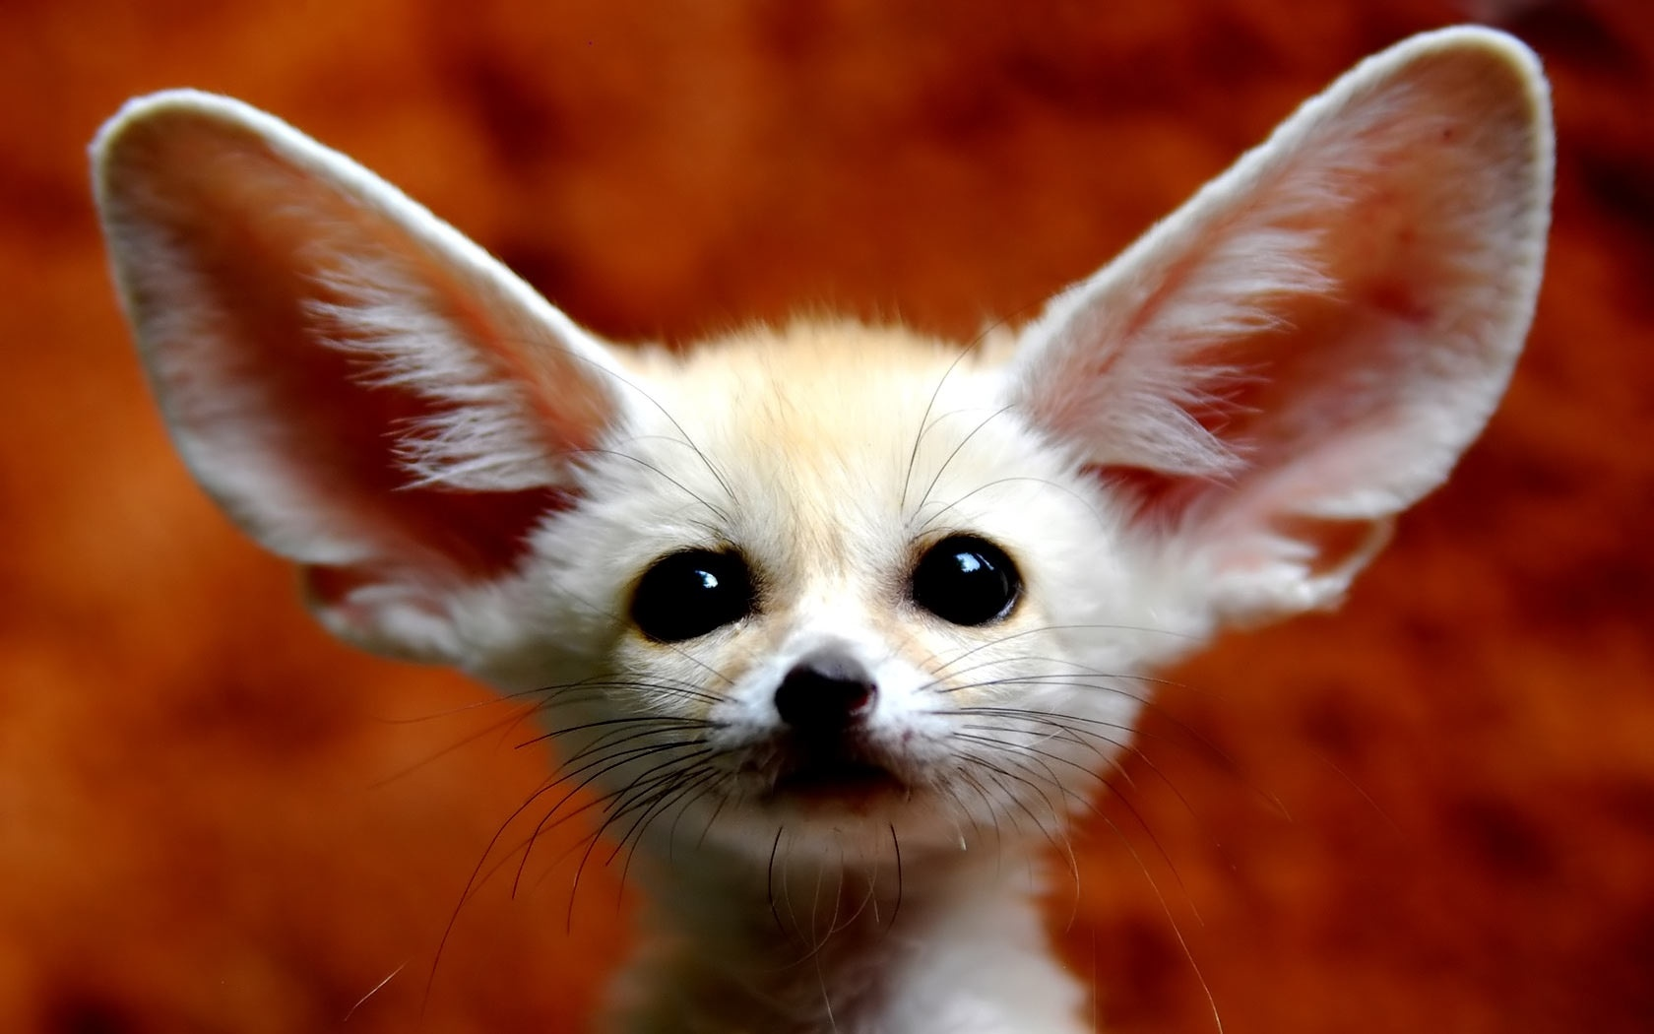
By jarvis taylor the fennec fox
Enjoy the cute fox pictures
Welcome to the most amazing report you will ever find about fennec foxes.

Slide 2
The fennec fox
Did you know fennec foxes also are called the bat eared fox, the desert fox, and the kit fox.
The fennec fox is made to survive the desert and you will learn most of the tools they have and use.
They live in little dug-out tunnels in the sandy ground. Probably because the lower you get the colder it becomes.
Fennec foxes have tall ears to let the heat exit their fur. These foxes also have very good hearing.
Fennec foxes hunt mice in their tunnels. Thanks to their excellent hearing, they can find mice easily. They also drink water from cactuses. Sometimes on rare rainy days, fennec foxes will drink the rain water. A fennec fox can also survive without water.

Slide 3
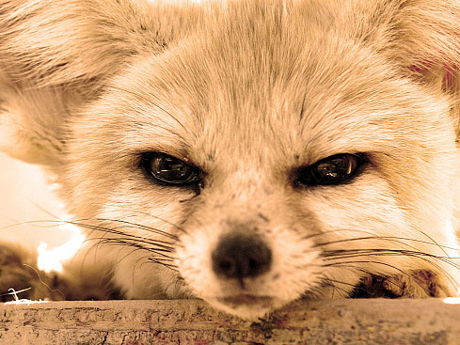
The fennec fox continued…..
Fennec foxes have awesome camouflage to hide from their enemy's like wolves, wild dogs and eagles.
A fully grown fennec fox is about the size of an ally cat and a baby is the size of a kitten. Which is pretty small for the fox family.
Did you know fennec foxes pure like cats when they’re happy.
They also live in small packs of about 10 fennecs.

Slide 4
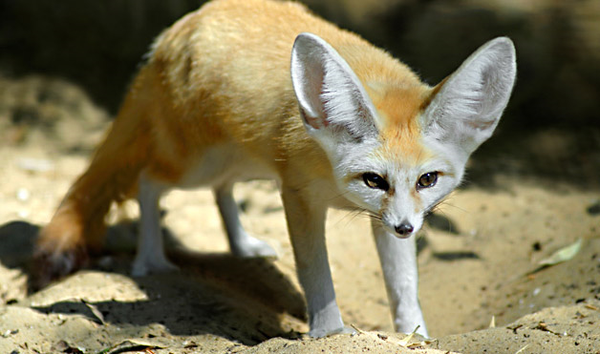
Foxes body parts
Long ears
Color of fur helps blend in
Stomach
Stores fat for food
Mouth for biting and eating
Paws for digging

Slide 5
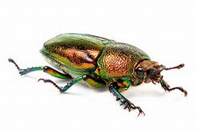
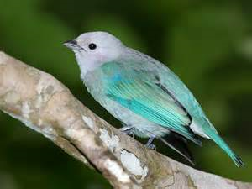
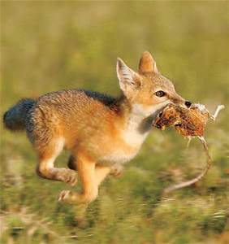
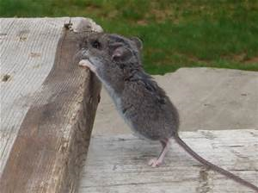
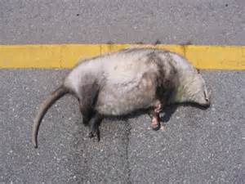
Fennec fox diet
Fully grown fennec foxes eat bugs, mice, birds, and already dead animals like road kill. Baby fennec foxes/ new born drink milk like lots of baby animals.

Slide 6
reproduction
As you can see to the right there is a baby fennec fox. The baby fennec fox is about the size of a baby kitten. Fully grown fennec foxes eat things like bugs and mice sometimes dead animals they found that were killed by something else like a car, bigger animal, or hunters. But baby fennec foxes cannot eat much. in fact they usually drink their mothers milk. a baby fennec fox relies on its mother for food and training for adult hood. If a fennec fox loses its mom then it has a high chance of dyeing. Ones day his new born fox may have children of its own.

Slide 7
The end
Bye bye
Bye guys I hope you liked my report on fennec foxes. I think fennec foxes are fascinating animals. I got my facts from Google and http://exoticpets.about.com/od/fennecfoxes/a/fennecfoxfacts.htm

