Slide 1
Farming in Ancient Egypt
By : Nathan and Bailey

Slide 2
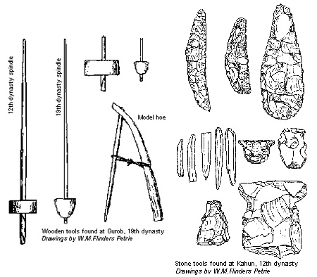
Farming in ancient egypt
Today, Bailey and I are going to tell you about Ancient Egyptian farming.

Slide 3
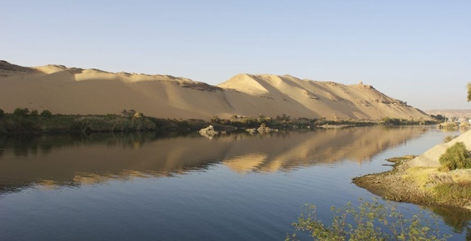
Nile river
The first thing we are going to talk about is the Nile River. Every year, The Nile River floods. Nutrients and moisture from the river create a fertile band of land on each side of the river. The Egyptians called the dark, fertile soil around the Nile, kemet, or “black land.” They called the dry land that surrounded it deshret, or “red land.” It was along the shores of the Nile that the desert tribes first settled.

Slide 4
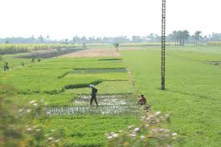
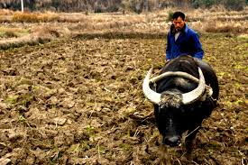
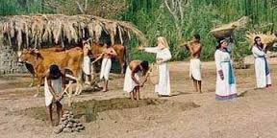
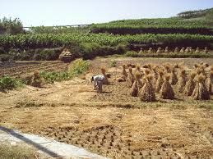
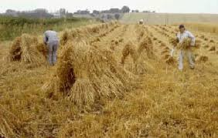
Colecting the crops
These pictures are with people are trying to get the hay from the ground.The one on the top with the two people are putting crops in the ground to get food or excesserize.

Slide 5
Crops
Egyptian farmers grew crops of wheat and barley for making bread and beer. Fibres from flax crops were used to make linen. A variety of fruits and vegies for grown in the worm climate and rich soil. Fig, date and pomegranate trees were important fruit crops. Grapes were grown to make wine. Egyptians also made use of plants such as papyrus that grew along the Nile.
This hieroglyph is of people farming. These pictures have animals. The one on the left, is two farmers who are getting wheat. The other hieroglyph is a farmer making soft soil for them to put wheat seeds in to keep the wheat growing.

Slide 6
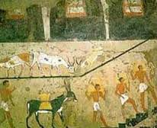
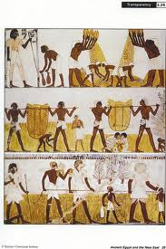
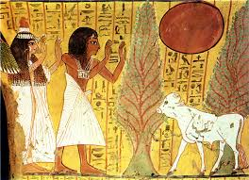
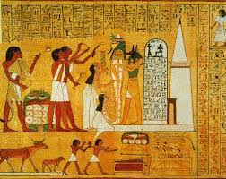
anamals
And these are hieroglyphs of people farming. All of these pictures has animals.

Slide 7
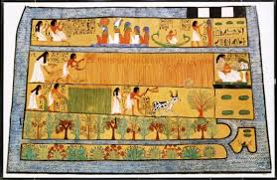
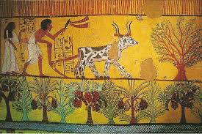
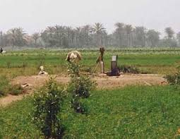
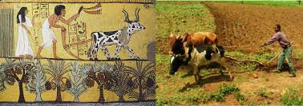
Hiroghlifics of farming
The picture in the middle right is with two people putting in tomato bushes and the left is people hardfesting fruit,vegables and wheat

Slide 8
conclusion
This is a video of Ancient Egyption farming video.
https://www.youtube.com/
watch?v=IiUafACfNkM

