Slide 1
Diving Deep
for
Synonyms
and
Antonyms
Created by
TEACHERS UNLEASHED

Slide 2
Welcome!
My name is Wendy, and
these are my diving
mates, Pat and Diana.
Together we will
discover the beauty of
the ocean, and describe
what we find with
synonyms and
antonyms.

Slide 3
Before we can dive in
you need to understand what
synonyms and antonyms are!
Antonyms
Are words that mean the opposite
Synonyms
Are words that mean the same
Let’s take a
closer look….

Slide 4
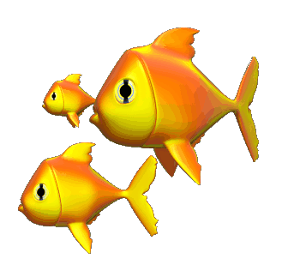
A Closer Look….
For example:
take the word ‘happy’
Synonyms
content
pleased
joyful
glad
cheerful
Antonyms
sad
miserable
gloomy
unhappy
depressed

Slide 5
Okay….Practice Time!
On your whiteboard or piece of paper, make a T-chart, and decide which words are synonyms and which are antonyms.
When you’ve finished…Check your work!
Synonyms will turn red, and
Antonyms will turn yellow!

Slide 6
Example
big
SYNONYMS
This is what it should look like!
ANTONYMS
Let’s get to it!
large
huge
gigantic
immense
tiny
small
little
puny

Slide 7
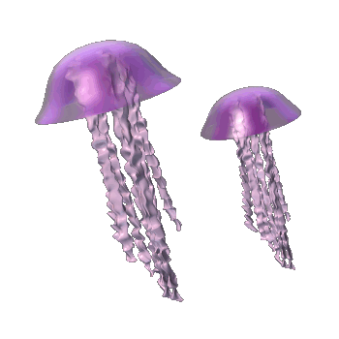
The jellyfish are very graceful and
beautiful.
attractive
ugly
gorgeous
revolting
lovely
stunning
hideous
horrible

Slide 8
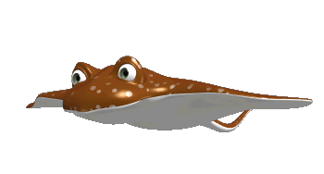
Stingrays can be extremely
dangerous.
treacherous
harmless
risky
safe
secure
protected
unsafe
hazardous

Slide 9
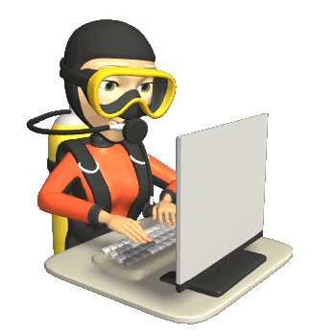
It is important that scuba divers are
smart.
sharp
unwise
intelligent
bright
clever
foolish
brainless

Slide 10
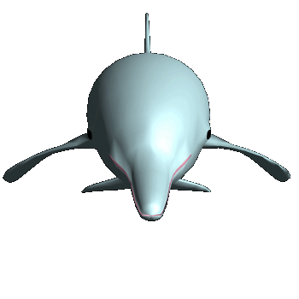
Many dolphins swim up to boats because they are
friendly.
mean
welcoming
offensive
pleasant
nasty
sociable
rude
gracious

Slide 11
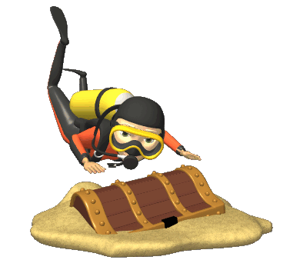
Buried treasure hidden by pirates is
mysterious.
strange
recognizable
familiar
identifiable
mystifying
odd
common
puzzling

Slide 12
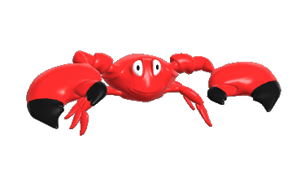
Crabs are very cautious of their surroundings and move
slowly.
sluggishly
swiftly
quickly
lethargically
unhurriedly
speedily

Slide 13
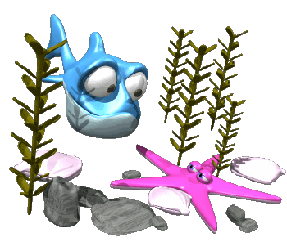
When fish find new places, they become very
curious.
bored
interested
nosy
unconcerned
inquisitive

Slide 14
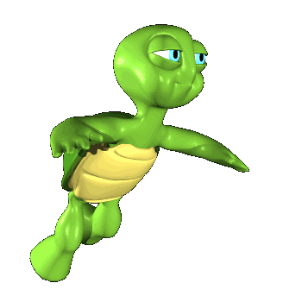
When sea turtles are swimming they look
silly.
levelheaded
goofy
sensible
serious
absurd
ridiculous

Slide 15
When sharks are hunting for prey, they can seem
scary.
pleasant
kind
frightening
chilling
terrifying
nice

Slide 16
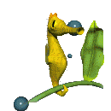
Seahorses can hold on to seaweed because their tails are
strong.
sturdy
tough
powerful
weak
scrawny
frail

Slide 17
You’re doing great!
Now let’s see if you can handle some test questions!!

Slide 18
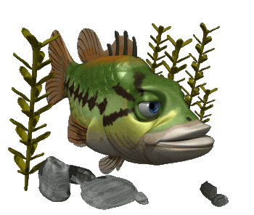
Pat and Diana reached the giant coral reef, and searched for fish.
What is an antonym for the underlined word?
huge
massive
tiny
enormous

Slide 19
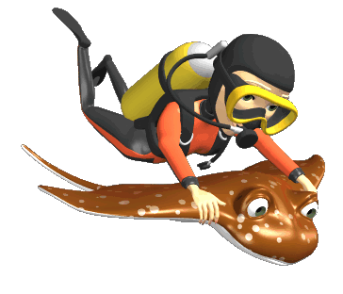
A beautiful manta ray gave Wendy a smooth ride through the ocean.
What is a synonym for the underlined word?
easy
rough
bumpy
violent

Slide 20
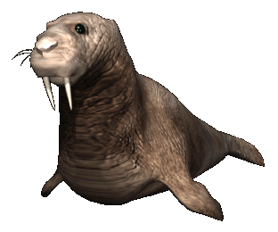
While diving deep, Wendy observed a cute, chubby seal just swimming by.
What is an antonym for the underlined word?
overweight
slender
plump
heavy

Slide 21
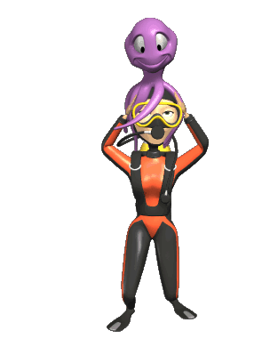
When Wendy got on the boat, an eight-legged friend came with her.
What is a synonym for the underlined word?
enemy
rival
adversary
buddy

Slide 22
Thank you for choosing:
TEACHERS
UNLEASHED
for this underwater adventure!
Visit our store at the link below:
www.teacherspayteachers.com/Store/Teachers-Unleashed

