Slide 1
Dinosaurs- spinosaurus
By annomas

Slide 2
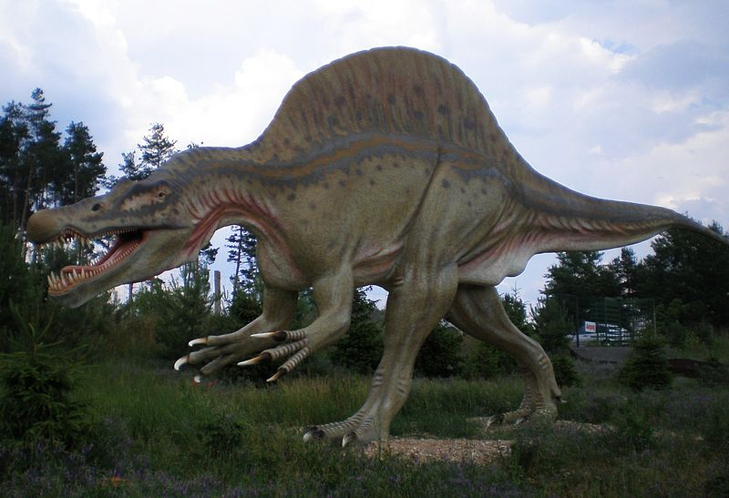
Stuff to know
Spinosaurus (meaning "spine lizard")
Spinosaurus grew to at least 1.65 meters (5.4 ft) long and were likely to have had skin connecting them, forming a sail-like structure, some authors have suggested that the spines were covered in fat and formed a hump. Multiple functions have been put forward for this structure, including thermoregulation and display.
Spinosaurus is a genus of theropod dinosaur found in what is now North Africa, from the lower Albian to lower Cenomanian stages of the Cretaceous period, about 112 to 97 million years ago.

Slide 3
Stuff to know continued
People think spinosaurus may have swam.
Spinosaurus’s The skull had a narrow snout filled with straight conical teeth that lacked serrations
It is whether Spinosaurus was primarily a terrestrial predator or a piscivore, as indicated by its elongated jaws, conical teeth and raised nostrils.

Slide 4
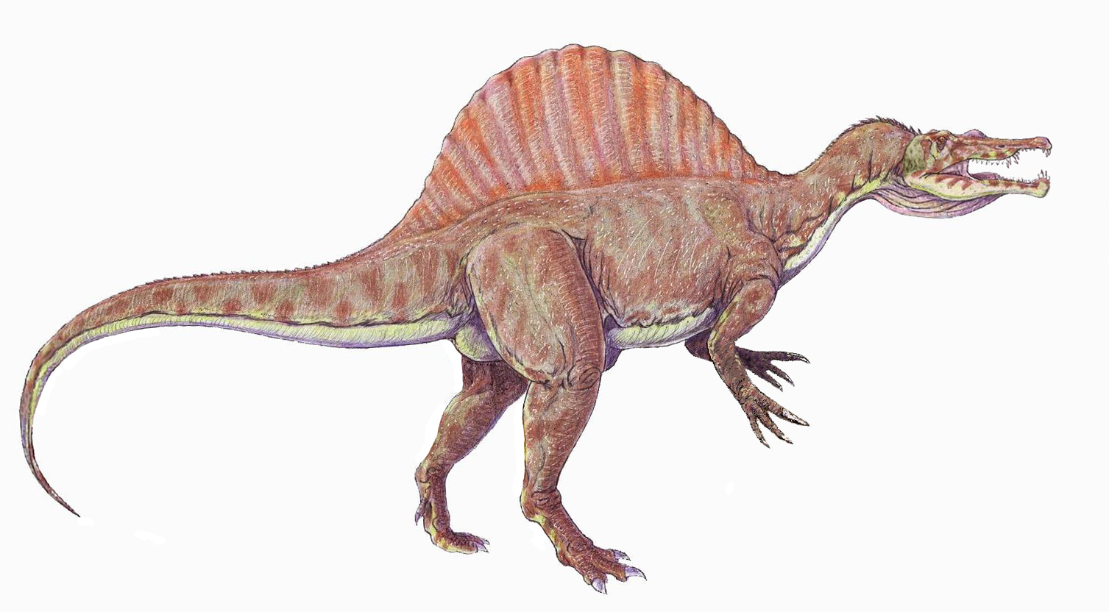
The spinosaurus
teeth

