Slide 1
Cheetahs
By: Emma and Kyla

Slide 2
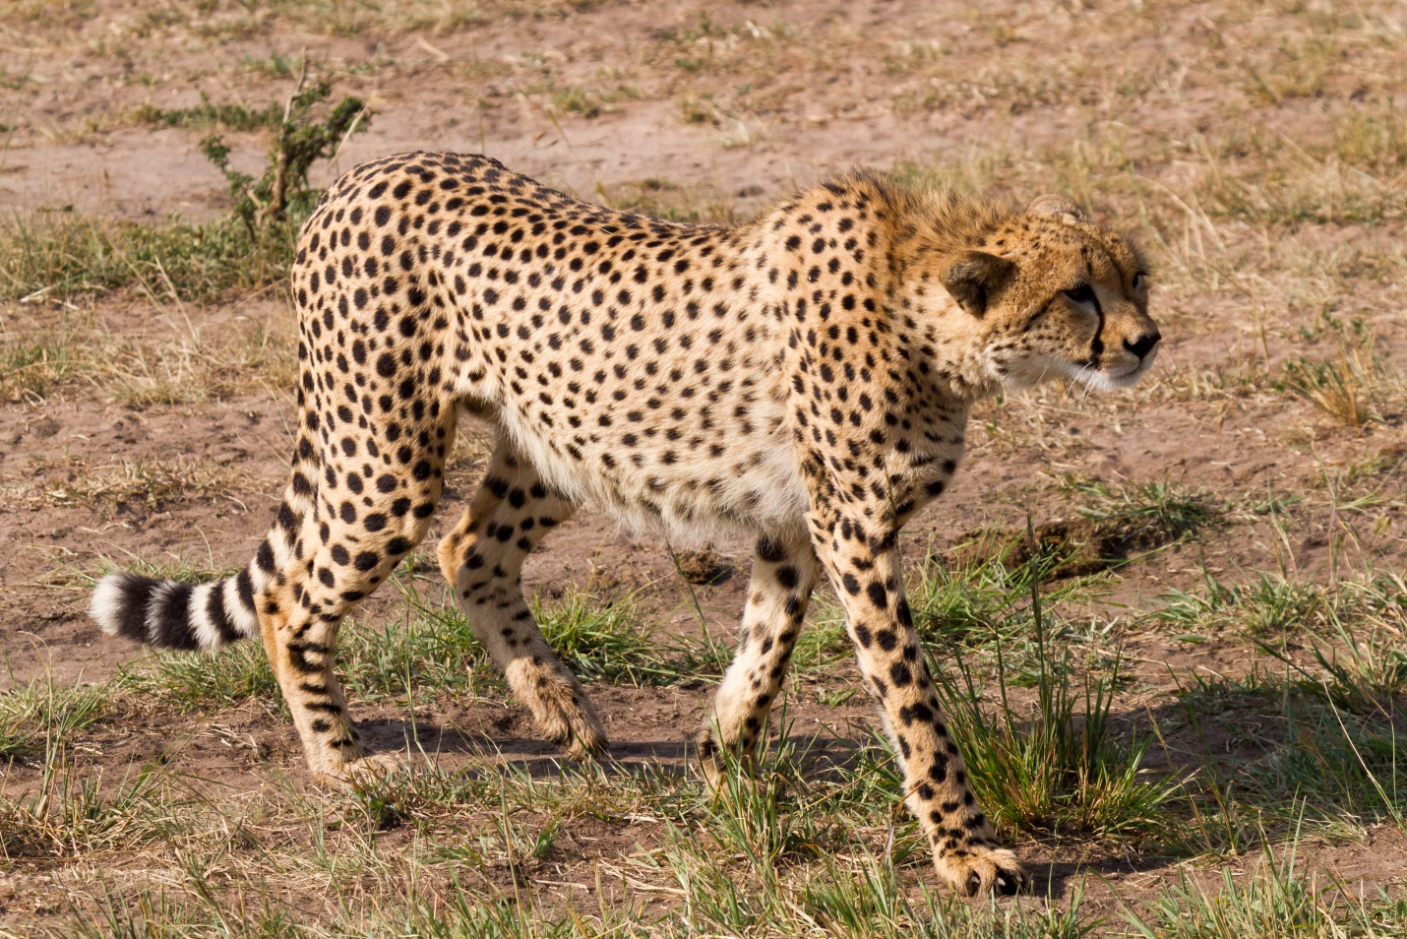
Today we are going to be telling you about Cheetahs. As you know we love Cheetahs. I hope you like this enjoy!!!

Slide 3
Cheetahs are brown with black spots. Each cheetah has a different set of spots.

Slide 4
What Cheetahs like to do
Cheetahs like to hunt , mark their territory, the mom will take care of young and take brakes after they run.

Slide 5
How long Cheetahs live
The life span of a cheetah is approxitmly 10 to 12 years in the wild. Or some Cheetahs live up to 20 years or longer in Captivity.

Slide 6
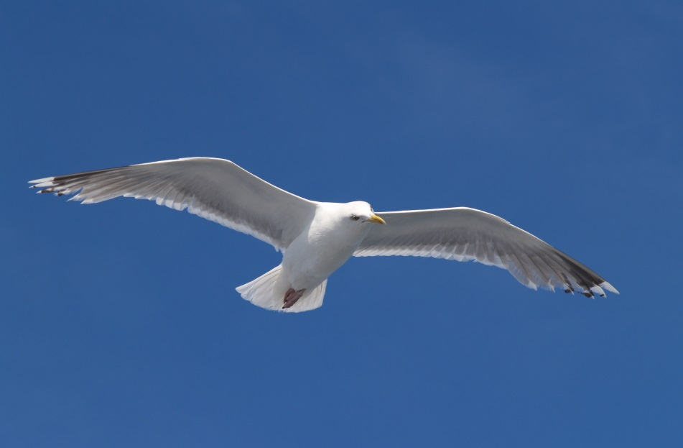
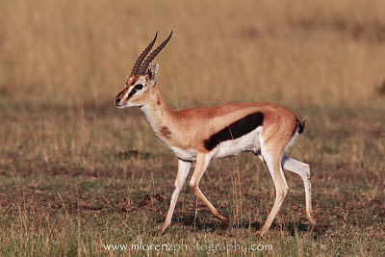
What Cheetahs like to eat.
Cheetahs like to eat deer , gazelle , birds and smaller mammals.

Slide 7
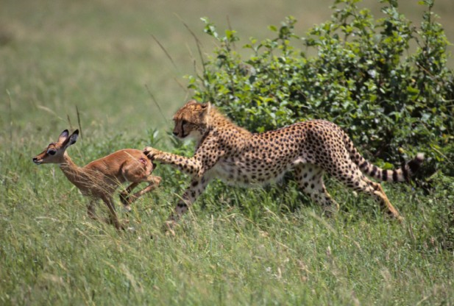
How Cheetahs hunt
Before Cheetahs start to unleash their speed they use their keen eye sight to scare their grass land environment.

Slide 8
Cheetahs live in the Safari of Africa and Asia. They live in the bushes and around trees. They live in that type of place because their fur blends in with their surrounding.

Slide 9
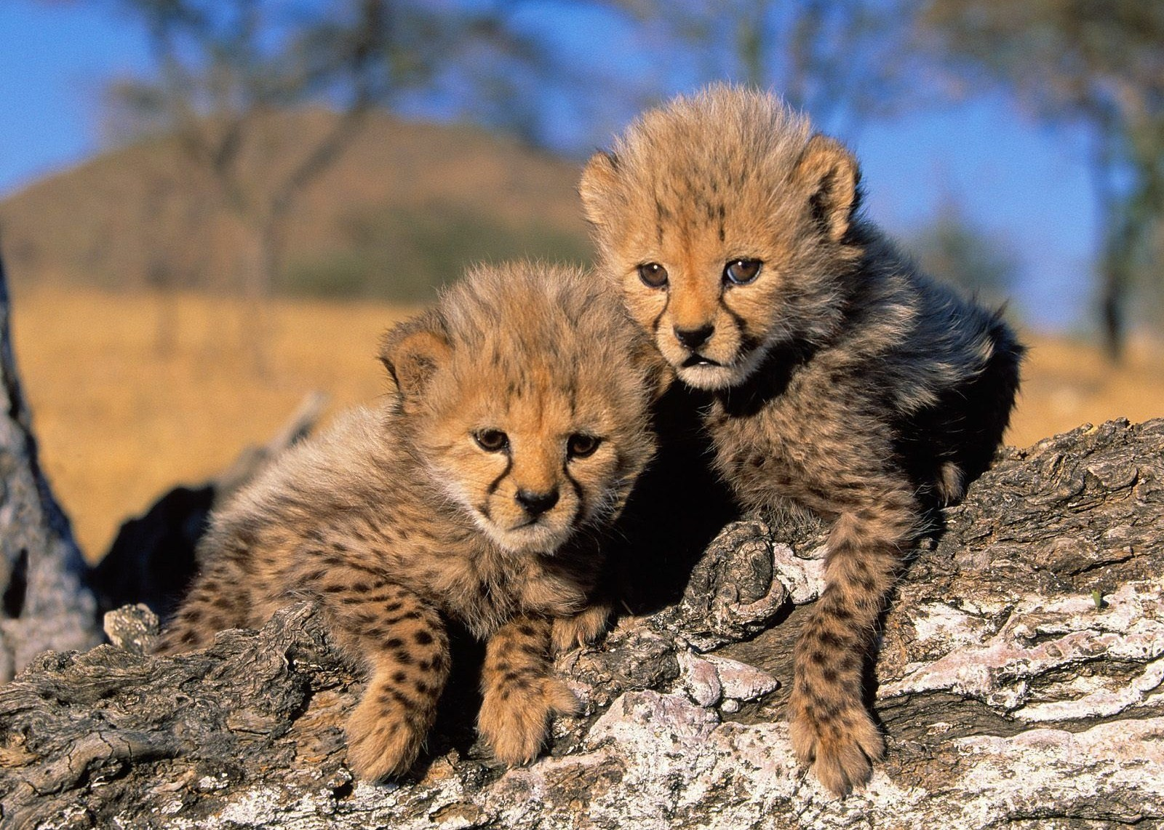
Cheetah Cubs
Hyenas, Lions and leopards can hurt Cheetah cubs. Their mother moves them every day. Cheetah cubs look soft and cuddly, but their coats are actually thick and scratchy. Only the fur on their spots is soft.

Slide 10
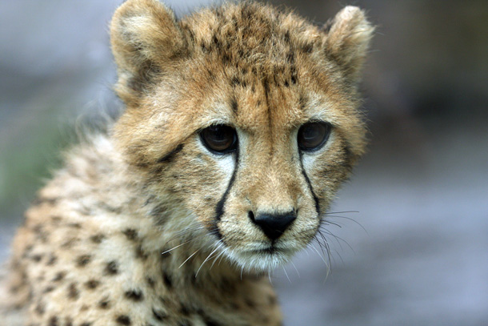
What Cheetahs like to do
Cheetahs like to play leap frog, climb trees ,Chase, spin and leap they use some of these skills when they go hunting. Cheetahs cubs like to clean each other.

Slide 11
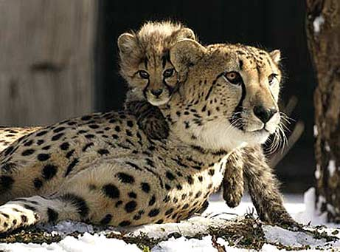
There mother will leave them at one and a half years old. The cubs stay together for a couple more months once the mother leaves them.

Slide 12
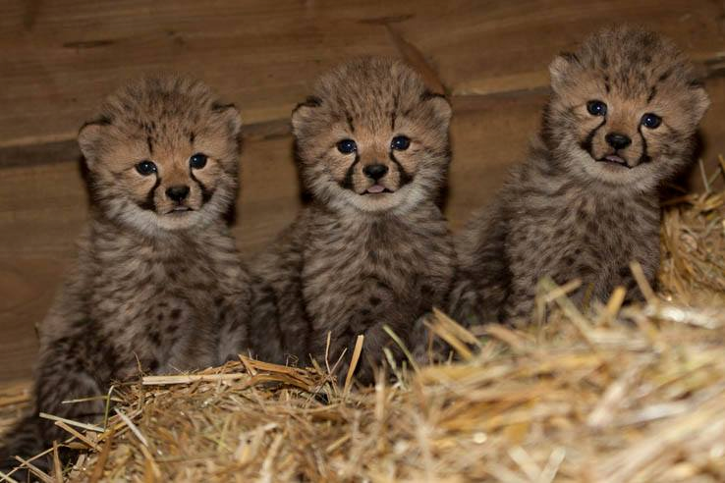
Thank you for listening to our descriptive report I will tell you what we used below.
-Wikipedia
-”Cheetah cubs”
-”Mammals”
-”Wild Animals”
-”The Mammals”

