Slide 1
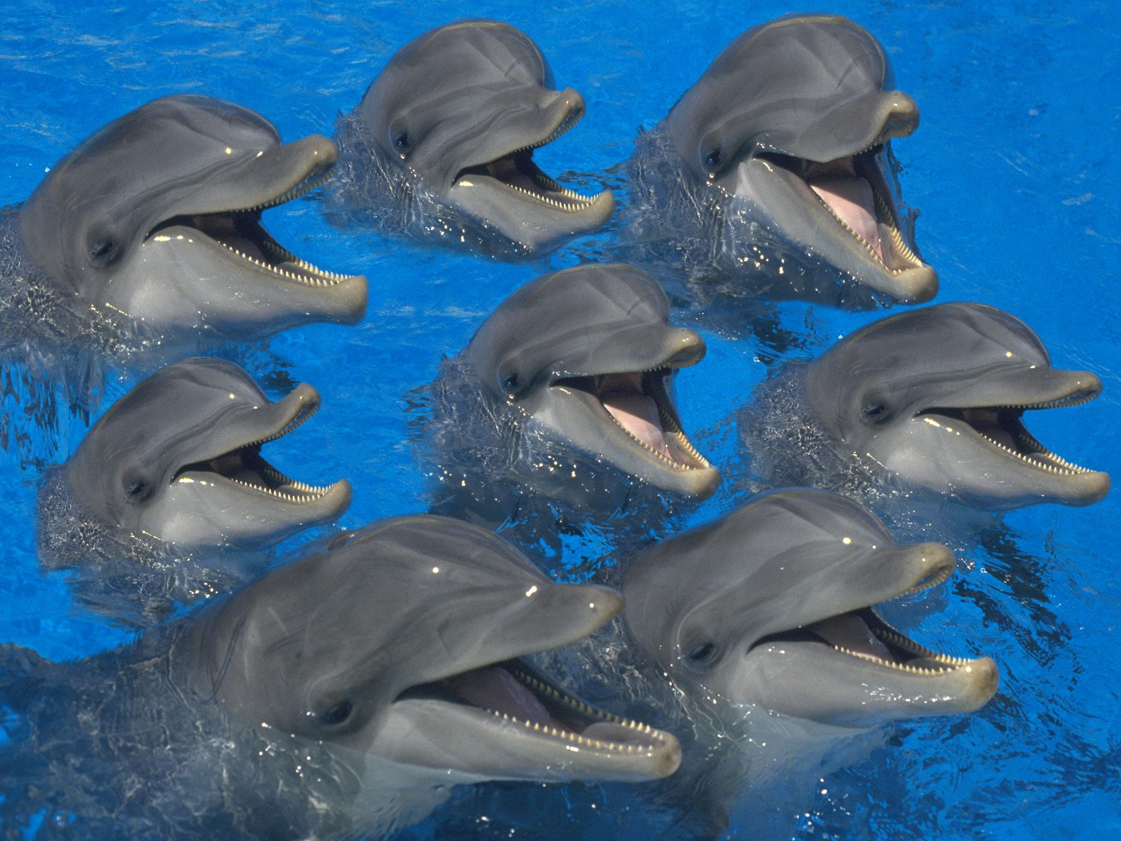
Bottlenose dolphins by: Chloe

Slide 2
intro
Today I'm going to tell you all about this playful creature!!! Please enjoy it☺☺☺☺

Slide 3
Playtime!!!!!
These very playful creatures get a lot of attention in a zoo . zoo keepers give dolphins balls and other pool items.

Slide 4
Are you hungry???
Bottlenose dolphins eat smaller fish and occasionally squid. Did you know that bottlenose dolphins do not use their teeth to hunt? They use them more for rounding up the fish, like sheepdogs herd sheep.

Slide 5
Bottlenose dolphins in their natural habitat☺☺☺
Bottlenose dolphins live around the coastlines and where fisher men fish, because when the fishermen don’t want the fish they throw them away so the dolphins eat them.

Slide 6
Extinct or not??????
These dolphins ARE NOT extinct. Of coarse they may seem to be but they are really common.

Slide 7
A baby and a mother
a mother bottlenose dolphin always takes good care of her calve by staying by his or her side to help the calve learn how to swim.

Slide 8
Hope you liked my power point about bottlenose dolphins. These are the websites I used: google and wiki

