Slide 1
Animals in Egypt
Made by Rylie & Khalid

Slide 2
I hope you are ready to learn about the animals of Egypt.

Slide 3
Cape hyray
The hyraxes are fairly small, thickset mammals. They are herbivores. Which means that they eat plants and grass. They are about the size of a domestic cat. They are furry with rounded bodies and a stumpy tail. They are native to Africa and the Middle East.

Slide 4
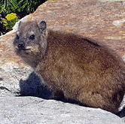
Cape hyray

Slide 5
dugong
These animals live in warm coastal waters from East Africa to Australia, including the Red Sea, Indian Ocean, and Pacific Ocean.
A Dugong is a Manatee. It can live for around 70 years. It has no dorsal fins. It is vulnerable to extinction. It is a herbivor. Its snout is downturned, to adapt to grazing for seagrass.

Slide 6
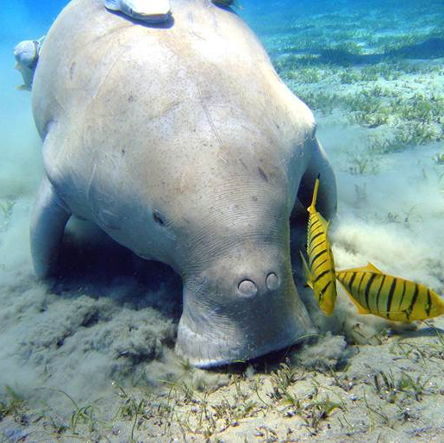
Dugong

Slide 7
Golden Spiny Mouse
The golden spiny mouse gets its name from the reddish-orange spiny fur that covers its body from head to tail. Its flanks are yellow and its underside is pale. It has gray legs with pale feet and black soles. It is also described as having a small, but distinct white spot under each eye. It is often found in the wild missing a part or all of its tail because it is able to shed this as a defense mechanism.It lives an average of three years in the wild. It feeds on seeds, desert plants, snails, and insects. The golden spiny mouse thrives in dry, hot deserts and is common in Egypt and much of the Middle East, including Jordan, Israel, and Saudi Arabia.

Slide 8
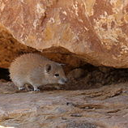
Golden spiny mouse

Slide 9
The end
powered by squirrel.inc
Credit goes to Wikipedia for most of the information
Thank you for listening to this presentation.

